Slide 1
vfc©
weather to fly
meteorology for the commercial pilot

Slide 2
hello my name is
vfc©
Sean Tyrrell
seantyrrell@flyvfc.com
250-882-4483

Slide 3

Class outline
vfc©
http://www.tc.gc.ca/Publications/en/TP12881/PDF/HR/TP12881E.pdf
friday: pre-test, met theory
saturday: met theory, advanced theory - air mass, front
sunday: advanced theory - jet stream, aviation weather products, sample exam and take-up

Slide 4
day1
vfc©
pre-test, met theory

Slide 5

atmosphere
vfc©

Slide 6

Atmosphere properties
vfc©
mobility
expansion
compression

Slide 7

Atmosphere composition
vfc©
oxygen
21%
nitrogen
78%
water vapour, CO2, argon, others
1%

Slide 8
Atmosphere the key
vfc©
water vapour is water in its gaseous, invisible form
it is the key to visible weather formation
visible weather determines the possibility of visual (VFR) flight!

Slide 9

vfc©
Atmosphere divisions
thermosphere
mesosphere
stratosphere
troposphere
16

Slide 10
Atmosphere troposphere
vfc©
28000’ deep over the poles, 54000’ deep over the equator
pressure, density and temperature all decrease as we ascend into the troposphere
most visible weather occurs in the troposphere

Slide 11
Atmosphere tropopause
vfc©
a ‘pause’ is a boundary between atmopsheric divisions
the tropopause divides the troposphere and the stratosphere above
characterized by a lowest temperature of -56°C

Slide 12

Atmosphere stratosphere
vfc©
50000’ to 150000’ above earth’s surface
pressure and density continue to decrease but temperature rises towards 0°C in the upper stratosphere
due to existence of the ozone layer
temperature then decreases again in the stratopause

Slide 13
Atmosphere mesosphere
vfc©
150000’ to 250000’ above earth’s surface
pressure, density and temperature continue to decrease
temperature falls as low as -100°C in the mesopause
this is the coldest temperature found within the atmosphere and on earth

Slide 14
Atmosphere thermosphere
vfc©
500000’ to 500km above earth’s surface
pressure, density decrease yet an extreme rise in temperature is noted with an increase in altitude

Slide 15
Atmosphere thermosphere
vfc©
1500°C to 2500°C due to the kinetic theory of gases
absorbtion of intese solar radiation by few O2 molecules that remain create these high temperatures
above 160km in the thermosphere exists the anacoustic zone - no sound transmission

Slide 16
Atmosphere and beyond
vfc©
the exososphere is the last layer of the atmophere
has an upper boundary of approximately 190000km
mainly hydrogen molecules
influence of solar radiation energy on hydrogen molecules exceeds that of earth’s gravitational pull

Slide 17
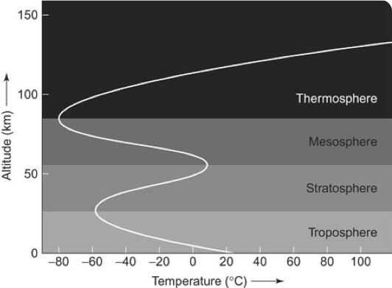
Atmosphere temperature
vfc©

Slide 18
Atmosphere standard
vfc©
for aeronautical engineering purposes, it is necessary to have a set of clearly defined standards to reference for aircraft design
pilots must be able to understand and apply this set of standards
integral in performance and altitude computations

Slide 19
Atmosphere ISA Properties
vfc©
the air is a perfectly dry gas
a mean sea level pressure of 29.92” Hg
a mean sea level temperature of 15°C
the rate of decrease of temperature with altitude is 1.98°C per 1000’

Slide 20
Atmosphere ISA Properties
vfc©
standard atmosphere only exists on paper

Slide 21


Atmosphere pressure
vfc©
pressure is the atmosphere exerting a force on the surface of the earth

Slide 22

Atmosphere barometer
vfc©
29.92” Hg

Slide 23

Atmosphere station pressure
vfc©
station pressure is the atmospheric pressure at the elevation of the observing station
station pressure
1” Hg change correlates to a 1000’ change in altitude

Slide 24
Atmosphere station pressure
vfc©
station pressure is simply the weight of the one square inch column of air “weighing down” on the station barometer
station pressure IS NOT the altimeter setting

Slide 25
Atmosphere density
vfc©
density is the ratio of the mass of an object in relation to the volume it occupies
atmospheric density decreases with altitude, increased temperature and increased humidity
this positively or negatively affects aircraft performance

Slide 26

Atmosphere density
vfc©
a parcel of air rises because it is of a lesser density than the air surrounding it
less dense

Slide 27
Atmosphere relationships
vfc©
atmospheric pressure and density are directly correlated
lower pressure equals lower density
pressure and therefore density decreases with an increase in altitude

Slide 28

altimetry
vfc©

Slide 29
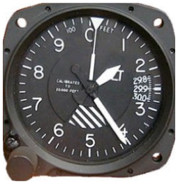
Altimetry altimeter
vfc©
modern day altimeters are referred to as sensitive altimeters
they are simply barometers, calibrated to display a change of 30’ with each milibar of pressure change
each needle is representitive of either hundreds, thousands or tens of thousands of feet
includes a subscale which is used to set the altimeter setting

Slide 30
Altimetry IALT
vfc©
indicated altitude (IALT) is the altitude as indicated on the altimeter above MSL when it is set to the current altimeter setting
it is simply “what the needles say” when the subscale is set correctly
IALT does not take into account non-ISA temperature or humidity values, or instrumentation error

Slide 31
Altimetry altimeter setting
vfc©
altimeter setting is either expressed as QNH or QFE
QNH is station pressure corrected to mean sea level (MSL) values - altimeter will read height in feet above sea level (ASL) in ISA conditions
QFE is station pressure corrected to a reference datum on the airfield - altimeter will read zero when at the datum in ISA conditions
QNH = “nautical height”, QFE = “field elevation”

Slide 32
Altimetry altimeter setting
vfc©
worldwide altimeter setting is expressed in millibars (mb) or hectopascals (hPa) - 1 mb = 1 hPa
altimeter setting is set on a subscale on the altimeter
EXCEPT in Canada, the United States and Columbia altimeter setting is expressed to the hundredth of an “Hg
ISA altimeter setting = 29.92”Hg = 1013.2 mb/hPa

Slide 33
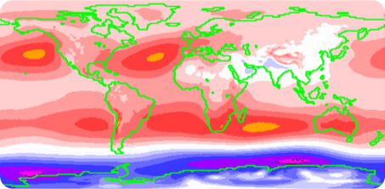
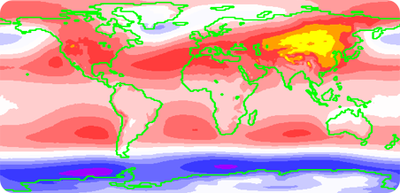
Altimetry altimeter setting
vfc©
15 year average MSL values, June - August
15 year average MSL values, December - February

Slide 34
Altimetry changing pressure
vfc©
when flying between areas of differing sea level pressure, the altimeter setting will change
if this change is ignored it can be extremely dangerous
this is because the altimeter is simply a barometer - the reading of the needles will change with changes in pressure
having the correct altimeter setting set appropriate for the area you are flying in ensures this reading is accurate

Slide 35
Altimetry high to low
vfc©
when flying from high to low pressure, the altimeter will over-read
the pilot’s reaction is to descend
this causes the pilot and aircraft to be lower than they think they are
“from high to low, lookout below”

Slide 36

Altimetry high to low
vfc©
30.92”Hg
28.92”Hg

Slide 37

Altimetry high to low
vfc©
28.92”Hg
30.92”Hg

Slide 38
Altimetry low to high
vfc©
when flying from low to high pressure, the altimeter will under-read
the pilot’s reaction is to climb
this causes the pilot and aircraft to be higher than they think they are
“from low to high, look to the sky”

Slide 39

Altimetry low to high
vfc©
28.92”Hg
30.92”Hg

Slide 40

Altimetry low to high
vfc©
28.92”Hg
30.92”Hg

Slide 41
Altimetry PALT
vfc©
pressure altitude (PALT) is the altitude as indicated on the altimeter above MSL when it is set to ISA pressure
PALT is the atmospheric pressure conditions the aircraft “thinks” it’s performing under
any non-standard (other than 29.92” Hg) altimeter settings will give non-standard performance

Slide 42
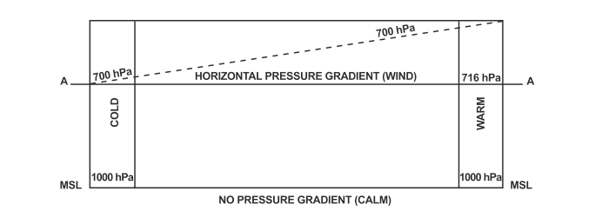
Altimetry cold air
vfc©
cold air will cause an altimeter to over read due to the steeper pressure gradient, when compared to warm air

Slide 43
Altimetry PALT
vfc©
PALT corrects for non-ISA sea level pressure settings only
aircraft performance charts (ie. takeoff, cruise, landing) are based on the aircraft’s pressure altitude
setting 29.92” Hg in flight will read PALT

Slide 44
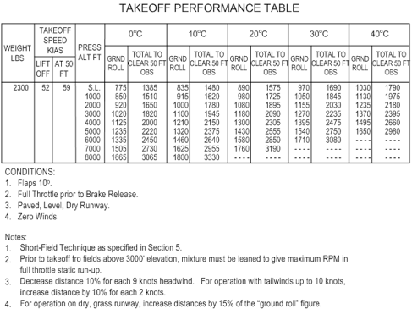
Altimetry PALT
vfc©
PALT is the standard for performance chart usage

Slide 45
Altimetry PALT formula
vfc©
PALT is calculated using the formula below:
PALT = station elevation +
[(29.92” Hg - altimeter setting) x1000]
1” Hg = 1000’

Slide 46
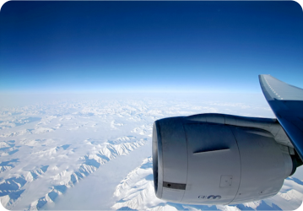
Altimetry DALT
vfc©
density altitude (DALT) is pressure altitude corrected for non-standard ISA atmospheric temperature conditions
it is the altitude at which the aircraft will perform as if it’s at given pressure, humidity and temperature variances from ISA

Slide 47
Altimetry DALT
vfc©
DALT is the most important value in terms of determining how an aircraft will perform
it is especially important under detrimental ISA conditions
hot, high, and humid

Slide 48
Altimetry DALT
vfc©
DALT may be calculated in the air, using an E6B flight computer, the outside air temperature and the PALT
it may also be calculated on the ground using a formula

Slide 49
Altimetry DALT formula
vfc©
DALT is calculated using the formula below:
DALT = PALT +
[100(OAT - ISA temperature)]
1” Hg = 1000’

Slide 50
Altimetry formulae
vfc©
DALT and PALT formulas, as any formulae, are truly remembered when they are understood
anticipate calculations by relating pressure and temperature values to standard
ie. lower than standard altimeter setting will give a higher pressure altitude than indicated - if not check your calculation

Slide 51

temperature
vfc©

Slide 52
Temperature imbalance
vfc©
it is due to global temperature differences that we see the creation of weather
these variances are due to a variety of factors, such as location, season, surface type etc.
creates large and small scale weather patterns versus one global weather pattern

Slide 53
Temperature radiation
vfc©
solar radiation is the energy transfer from the sun to the surface of the earth
terrestrial radiation is the energy transfer from the surface of the earth to the troposphere

Slide 54
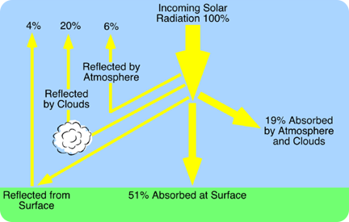
Temperature radiation
vfc©
only half of the incoming solar radiation is absorbed at the surface

Slide 55
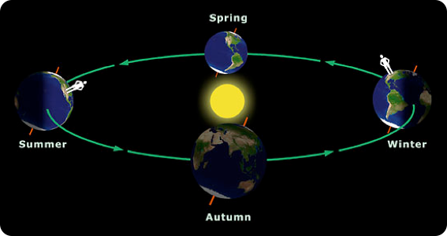
Temperature variation
vfc©
the earth spinning on a tilted axis causes seasonal variation

Slide 56
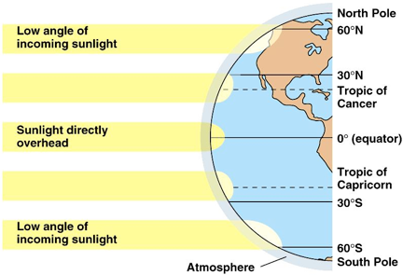
Temperature variation
vfc©
latitudinal variation accounts for global wind circulation patterns

Slide 57
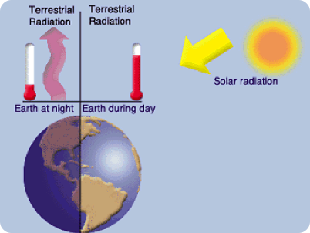
Temperature variation
vfc©
diurnal variation occurs when solar radiation ceases at sunset

Slide 58

Temperature variation
vfc©
surface variation determines how readily terrestrial radiation will occur due to absorption

Slide 59
Temperature heating
vfc©
tropospheric heating is due to heating from the ground up
conduction plays a very small role
there are many other processes involved which distribute heat throughout the troposphere

Slide 60
Temperature convective heating
vfc©
convective heating is due to the vertical cycle created by rising warm and descending cold air

Slide 61
Temperature advective heating
vfc©
advective heating occurs as cold air is warmed from below as it moves over a warmer surface

Slide 62
Temperature turbulent heating
vfc©
turbulence at the surface creates instability and causes heat to be forced aloft

Slide 63
Temperature compression
vfc©
descending air is compressed, increasing pressure and temperature, also known as subsidence

Slide 64
Temperature adiabatic heating
vfc©
the term adiabatic means that it is the act of compression itself that is heating the parcel of air
there is no external heating force affecting the air

Slide 65
Temperature cooling
vfc©
as with heating, numerous processes are involved besides radiation that cool the troposphere
radiation cooling itself only affects the surface based levels of the troposphere

Slide 66
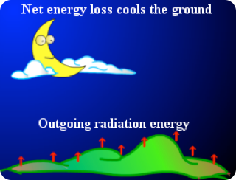
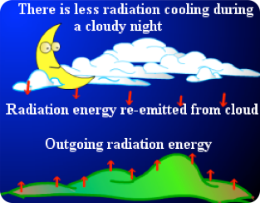
Temperature radiation cooling
vfc©
cooling due to terrestrial radiation at night depends on the existence of cloud

Slide 67
Temperature advective cooling
vfc©
advective cooling occurs as warm air is cooled from below as it moves over a colder surface

Slide 68
Temperature adiabatic cooling
vfc©
the term adiabatic means that it is the act of expansion itself that is cooling the parcel of air
there is no external cooling force affecting the air

Slide 69
Temperature isothermal
vfc©
an isothermal layer means there is no change in temperature with a change in altitude
it can occur if the predominant weather pattern is very stable
if a light mixing action is set up due to wind bringing together warm and cold air, an isothermal layer may be created

Slide 70
Temperature inversion
vfc©
an inversion means an increase in temperature with an increase in altitude
like an isothermal condition, it can occur if the predominant weather pattern is very stable
inversions are in fact so stable that they can give poor VFR flight conditions

Slide 71
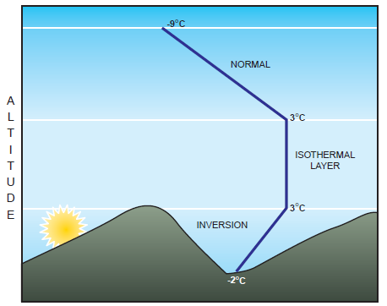
Temperature inversion
vfc©
inversions can commonly form in valleys at sunset
the setting sun warms the air in the upper valley after it has set on the cooling lower air below

Slide 72
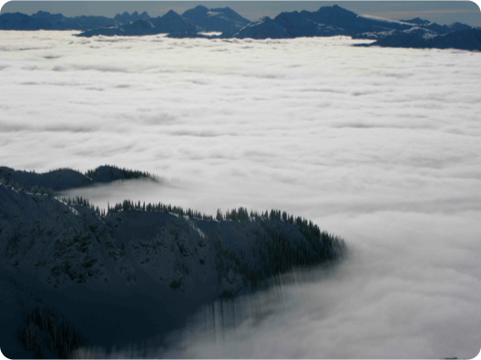
Temperature inversion
vfc©

Slide 73
Temperature inversion
vfc©
inversions may also form on cold, calm nights when terrestrial radiation ceases, cooling only the lowest levels of the troposphere
they may also occur with the passage of a cold front
inversions favour poor visibility in the cold air and are inherently stable so may persist for long periods of time

Slide 74
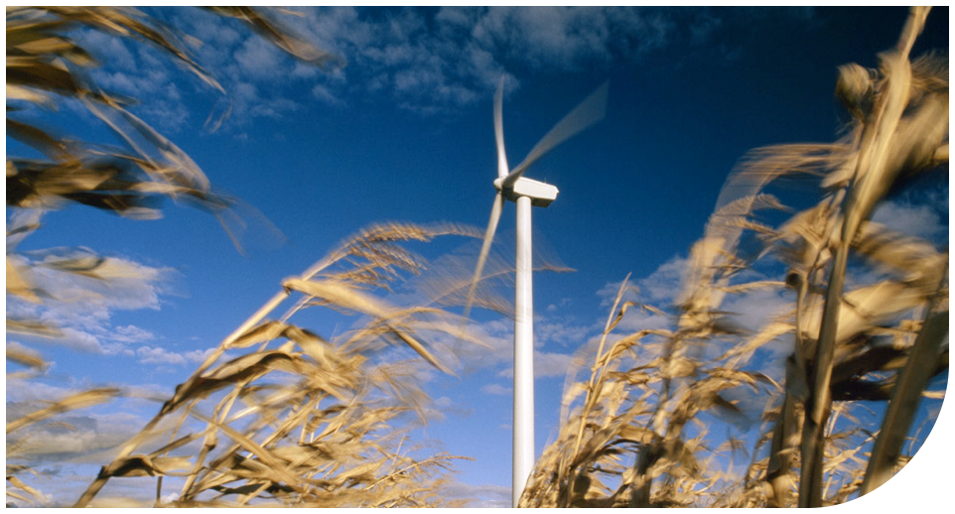
wind
vfc©

Slide 75
Wind pressure
vfc©
wind is simply the horizontal movement of air
solely due to pressure gradients
pressure gradients are “slopes” created by relative areas of high and low pressure

Slide 76

Wind pressure gradient
vfc©
isobars join points of equal sea level pressure to create a top down pressure “map”
isobars are without exception drawn at 4 mb intervals
knowing this you can determine the sea level pressure along each isobar
4 mb
4 mb
4 mb

Slide 77
Wind speed
vfc©
the closer the isobars, the steeper the pressure gradient, and the faster the wind speed
the further apart the isobars, the shallower the pressure gradient, and the slower the wind speed

Slide 78

Wind pressure gradients
vfc©
cross sectional view of isobars, steep and shallow gradients
4 mb
4 mb

Slide 79
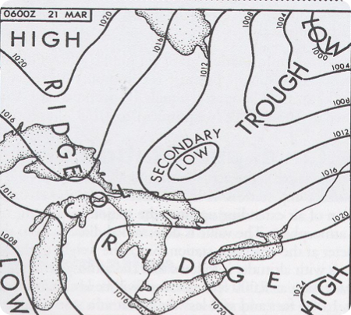
Wind pressure map
vfc©

Slide 80
Wind high
vfc©
an area of high pressure is also known as an anti-cyclone
it is an area of relatively high sea level pressure
wind moves clockwise around a high in the Northern hemisphere
a high is marked by descending and compressing air

Slide 81
Wind low
vfc©
an area of low pressure is also known as a cyclone
it is an area of relatively low sea level pressure
wind moves counter-clockwise around a low in the Northern hemishphere
a low is marked by ascending and expanding air

Slide 82
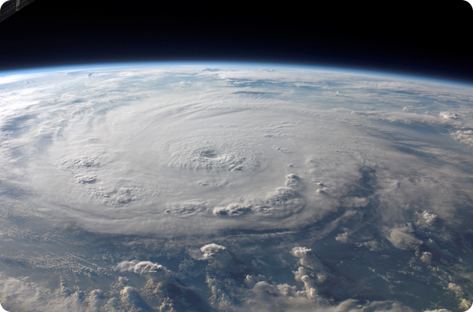
Wind low
vfc©

Slide 83

Wind pressure systems
vfc©
✗

Slide 84
Wind pressure systems
vfc©
✓

Slide 85
Wind movement
vfc©
wind does not move directly from areas of high to low pressure
it moves in relation to the isobars, following their curvature
how closely the wind follows the isobars is dependent on altitude

Slide 86
Wind movement
vfc©
wind moves off of and away from centers of high pressure, in a clockwise direction
wind moves down into and towards centers of low pressure, in a counter-clockwise direction
there are two forces besides the pressure gradient that determine wind movement

Slide 87
Wind coriolis
vfc©
the coriolis force is an apparent deflection of a moving body as viewed from a rotating reference frame
it is a major factor in explaining why wind moves the way it does
coriolis causes an apparent deflection of a moving body to the right in the Northern hemisphere

Slide 88
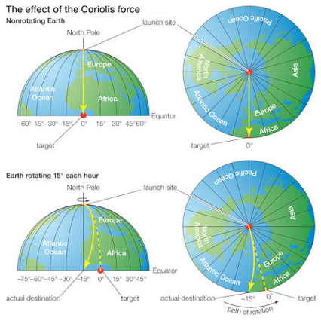
Wind coriolis
vfc©

Slide 89
Wind coriolis
vfc©
coriolis affects the apperent motion of all moving bodies
however it is only influential on objects moving on northerly or southerly tracks
it has a negligible effect upon objects moving east and west, as well as objects moving closer to the poles

Slide 90
Wind centrifugal
vfc©
centrifugal force draws a rotating body away from its center of rotation
equal and opposite to centripetal force
remember wind moving in pressure systems is a rotating body

Slide 91
Wind centrifugal
vfc©
centrifugal force works with the pressure gradient force when acting on wind blowing out from a high
centrifugal force works against the pressure gradient force when acting on wind blowing into a low
the net result is an increased wind speed blowing out of a high and a decreased wind speed blowing into a low

Slide 92

Wind buys ballots law
vfc©
Buys Ballot’s law states that in the Northern hemisphere standing with your back to the wind, the area of low pressure will be to your left
✈
✈
✈

Slide 93
Wind notation
vfc©
wind direction is indicated as a bearing, either in degrees true or magnetic depending on the type of information
wind is reported or forecast as coming from a specific bearing, rounded to the nearest ten degrees
wind speed is always observed or forecast in nautical miles per hour (KTS)

Slide 94
Wind veer
vfc©
a wind that changes direction clockwise is termed a veering wind
ie. a wind of 180° changes to a wind of 230°

Slide 95
Wind back
vfc©
a wind that changes direction counter-clockwise is termed a backing wind
ie. a wind of 230° changes to a wind of 180°

Slide 96
Wind surface
vfc©
surface wind is generally termed as winds below 3000’ AGL
surface wind is influenced by surface friction, which slows its speed
a reduce wind speed means a lesser apparent deflection due to the coriolis force, causing movement across isobars

Slide 97
Wind surface
vfc©

Slide 98
Wind surface
vfc©
a reduction in coriolis leads to greater influence on the wind by the pressure gradient force
the result is less of an apparent deflection to the right
this is a backing wind

Slide 99
Wind aloft
vfc©
aloft wind is generally termed as winds above 3000’ AGL
aloft wind is not influenced by surface friction, which increases its speed
an increased wind speed means a greater apparent deflection due to the coriolis force, causing movement parallel to the isobars

Slide 100
Wind aloft
vfc©

Slide 101
Wind aloft
vfc©
an increase in coriolis leads to lesser influence on the wind by the pressure gradient force
the result is more of an apparent deflection to the right
this is a veering wind

Slide 102
Wind surface and aloft
vfc©
surface
aloft

Slide 103
Wind surface and aloft
vfc©
during a descent from aloft to the surface, the wind is seen to decrease in intensity and back
during a climb from the surface to aloft, the wind is seen to increase in intensity and veer

Slide 104
Wind circulation
vfc©
global temperature differences create global atmospheric circulation
large scale prevailing winds, such as the northeastern trade winds in the tropics
pressure gradient force, coriolis force, centrifugal force all need to be considered

Slide 105
wind circulation
www.nullschool.net

Slide 106
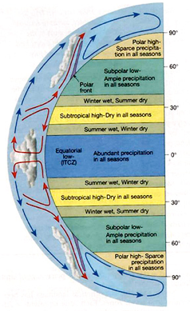
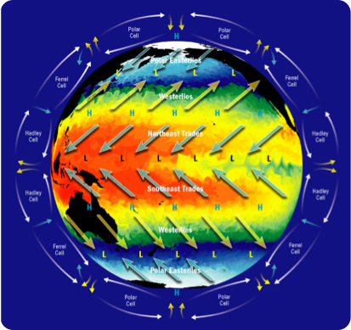
Wind circulation
vfc©

Slide 107
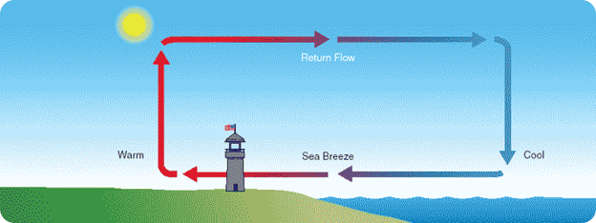
Wind sea breeze
vfc©
the wind blows on shore during the day due to the convective circulation cycle started as warm air rises over the warmer land surface

Slide 108
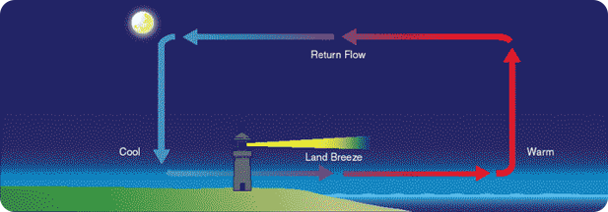
Wind land breeze
vfc©
the wind blows off shore during the night due to the convective circulation cycle started as warm air rises over the warmer water surface

Slide 109
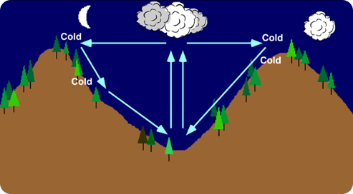
Wind katabatic
vfc©
the wind blows down mountain slopes into valleys at night as the surface of the slopes are cooled

Slide 110
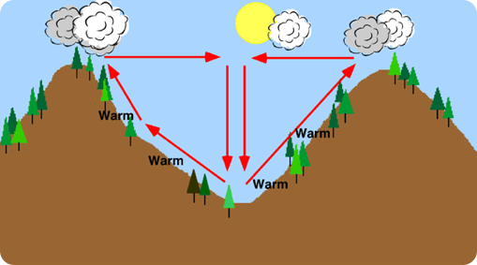
Wind anabatic
vfc©
the wind rises up mountain slopes out of valleys during the day as the surface of the slopes are heated

Slide 111
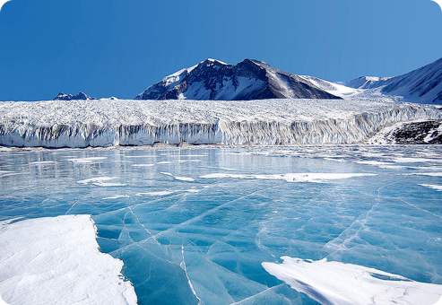
Wind glacial
vfc©
the wind blows down glacial slopes much like a katabatic wind due to the cold dense air cooled by the glacier

Slide 112
Wind shift
vfc©
a gust is a rapid and irregular fluctuation in the movement of air caused commonly by mechanical turbulence and convection
a squall is a sudden increase in wind strength of a greater intensity than a gust, usually caused by thunderstorm passage

Slide 113
Wind shear
vfc©
wind shear is the tearing effect that can be experienced along the border of two zones which have different wind speeds and intensities
shear may severely impact aircraft performance, especially critical during take-off and landing

Slide 114
Wind shear
vfc©
increased performance wind shear is encountered with an increase in headwind or decrease in tailwind component
on approach, increased performance shear requires a net increase in power to maintain the ideal approach path

Slide 115
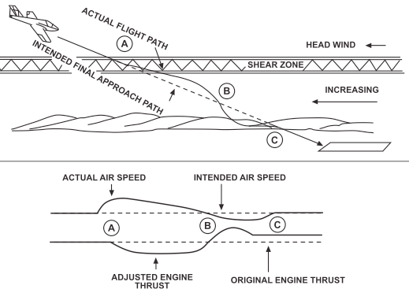
Wind shear
vfc©

Slide 116
Wind shear
vfc©
decreased performance wind shear is encountered with an decrease in headwind or increase in tailwind component
on approach, decreased performance shear requires a net decrease in power to maintain the ideal approach path

Slide 117
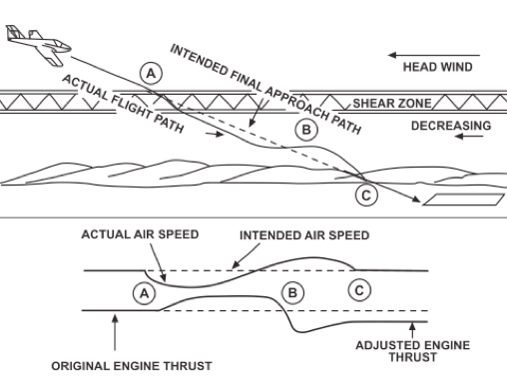
Wind shear
vfc©

Slide 118
day2
vfc©
met theory continuation, air masses, fronts

Slide 119
vfc©
USING ALL AVAILABLE INFORMATION, WHAT IS THE DENSITY ALTITUDE (DALT) AT CALGARY INTERNATIONAL AIRPORT THIS MORNING, AT 1500Z?

Slide 120

stability
vfc©

Slide 121
Stability vertical displacement
vfc©
stability is used to to describe how resistant air is to vertical displacement
stable air resists vertical displacement
unstable air continues movement in the direction of displacement

Slide 122

Stability vertical displacement
vfc©
stable
unstable

Slide 123
Stability temperature
vfc©
stable
unstable

Slide 124
Stability lapse rate
vfc©
lapse rate is a vertically descriptive rate of temperature change with altitude
a steep lapse rate implies a large temperature change within a given vertical distance
a shallow lapse rate implies a small temperature chage within a given vertical distance

Slide 125
Stability lapse rate
vfc©
lapse rate is a key indicator of air stability
a steep lapse rate indicates unstable air
a shallow lapse rate indicates stable air

Slide 126
Stability temperature
vfc©
shallow and stable
steep and unstable

Slide 127
Stability air
vfc©
stability is a key determinant of weather and its severity
knowledge of stability allows pilots to predict weather conditions that will affect their flight

Slide 128
Stability stable air
vfc©
little or no turbulence
steady winds
layer cloud
continuous precipitation
poor visibility, especially in the lower levels

Slide 129
Stability unstable air
vfc©
turbulent
gusting winds
vertically developed cloud
intermittent precipitation
generally good visibility

Slide 130

turbulence
vfc©

Slide 131
Turbulence defined
vfc©
turbulence is a random spinning motion of air, or when it develops an abrupt updraft or downdraft
aircraft reaction to turbulence is dependant on a variety of factors
aircraft design, size, speed, wing loading and altitude will all determine this reaction

Slide 132
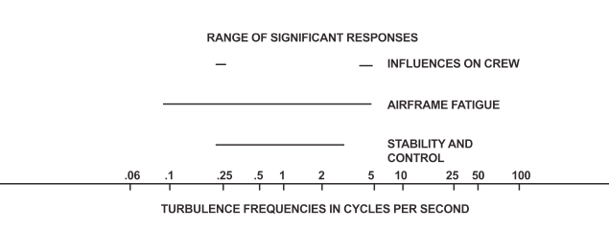
Turbulence frequency
vfc©
a factor in the determination of turbulent effect is its frequency

Slide 133
Turbulence classification
vfc©
turbulence is classified based on what causes it
mechanical
convective
shear
wake
clear air (jet stream)

Slide 134
Turbulence intensity
vfc©
turbulence intensity is forecast and reported as follows:
LIGHT: small, erratic changes in altitude and attitude
LIGHT CHOP: light turbulence with a rapid, rhythmic component
MODERATE: greater intensity than light, often with variations in indicated airspeed, aircraft still in positive control

Slide 135
Turbulence intensity
vfc©
MODERATE CHOP: greater intensity than light chop, without appreciable changes to attitude and/or altitude
SEVERE: large, abrupt changes in aircraft attitude and altitude, usually accompanied by large variations in indicated airspeed - aircraft may be temporarily out of control
EXTREME: aircraft out of control, structural damage possible

Slide 136
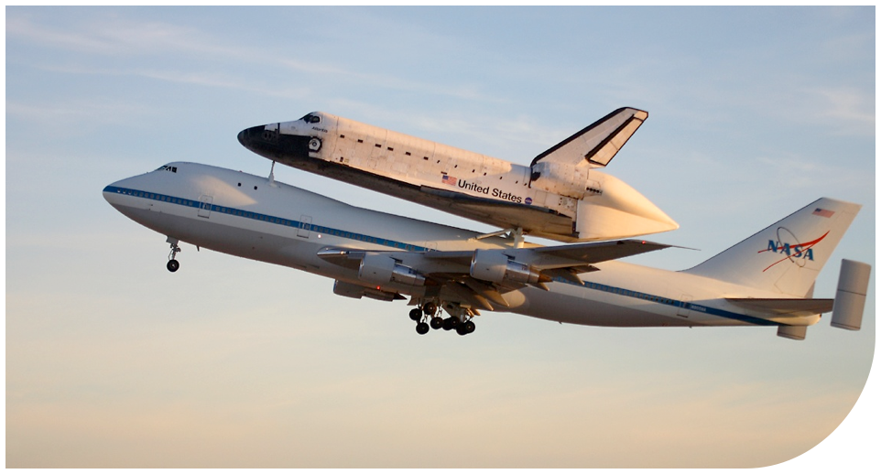
lift
vfc©

Slide 137
Lift lifting agents
vfc©
convection
orographic
fronts
turbulence
convergence

Slide 138
Lift convection
vfc©
convective heating creates lift and with it a high degree of instability

Slide 139
Lift orographic
vfc©
orographic implies large-scale geographic features
air will continue its unstable movement downwind of a mountain range

Slide 140
Lift frontal
vfc©
frontal lift is an immensely powerful lifting force
fronts = active weather
C
W

Slide 141
Lift turbulence
vfc©
turbulent eddies may be carried aloft if the air is inherently unstable and winds are strong

Slide 142
Lift convergence
vfc©
air falling down the pressure gradient converges at the bottom of a low
forces air aloft creating large-scale lift
L

Slide 143

saturation
vfc©

Slide 144
Saturation atmospheric moisture
vfc©
water vapour is the key to visible weather fromation
water vapour exists in the atmosphere due to transpiration from vegetation, and evaporation from bodies of water
water vapour is the invisible form of atmospheric moisture
liquid or crystalline are visible forms of moisture

Slide 145
Saturation state of change
vfc©
water vapour’s change of state creates visible moisture
water vapour may condense into a liquid or sublimate directly to a solid
attention must be paid to the energy transfer during these reactions in order to understand visible weather formation

Slide 146
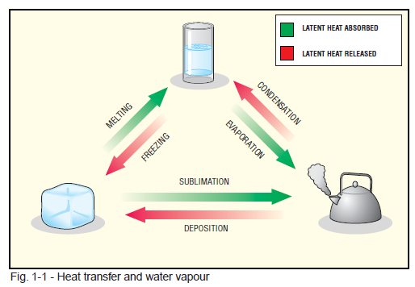
Saturation state of change
vfc©

Slide 147
Saturation state of change
vfc©
energy released during the process of condensation is know as the latent heat of vaporization
energy released during the process of freezing is known as the latent heat of fusion
this energy release into the atmosphere creates our most powerful weather phenomena

Slide 148
Saturation saturated
vfc©
the maximum pressure due to water vapour a volume of air may hold is governed by its temperature
saturation implies this volume of air holds the maximum pressure of water vapour it can, at its given temperature

Slide 149
Saturation relative humidity
vfc©
relative humidity is defined as the ratio between the partial pressure of water vapour and the saturated vapour pressure of water
partial pressure implies water vapour is only one component of the total gaseous pressure of a volume of air
the saturated vapour pressure of water is simply the pressure at which a volume of air must reach in order for gaseous water to change state (condense or deposit)

Slide 150
Saturation temperature
vfc©
temperature governs the pressure of the volume of air
lower temperature raises air pressure, of which water vapour pressure is a part of, decreasing the difference between it and the saturated vapour pressure of water
this decreasing difference is represented by an increase in relative humidity

Slide 151
Saturation increasing pressure
vfc©
a volume of air may have its vapour pressure increased towards saturation in two ways
by cooling...
or by increasing its water content

Slide 152

Saturation increasing moisture
vfc©
50% relative humidity
100% relative humidity
100% relative humidity

Slide 153
Saturation dew point
vfc©
dew point is the temperature a volume of air must be cooled to in order for water vapour to condense into water
dew point is a saturation temperature
dew point and relative humidity are related

Slide 154
Saturation cooling
vfc©
100% relative humidity
50% relative humidity

Slide 155
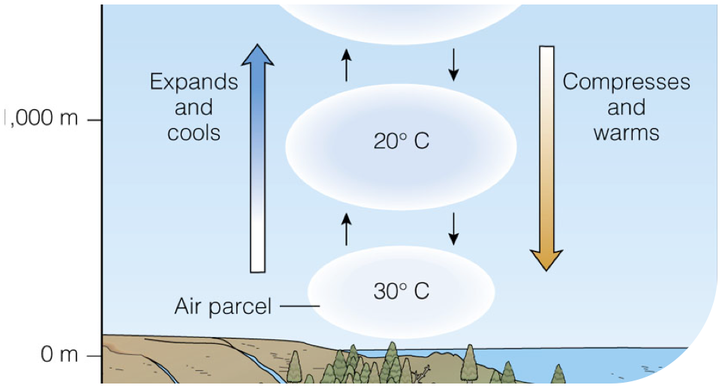
Lapse rate
vfc©

Slide 156
Lapse rate defined
vfc©
lapse rate is a measurement of how quickly air cools when ascending a given vertical distance
in non-inversion conditions, this is said to be a positive rate
in an inversion, this rate is negative

Slide 157
Lapse rate values
vfc©
there are four adiabatic lapse rates that need to be understood:
standard adiabatic lapse rate (STALR): 1.98°C/1000’
dry adiabatic lapse rate (DALR): 3°C/1000’
saturated adiabatic lapse rate (SALR): 1.5°C/1000’
environmental adiabatic lapse rate (EALR): 2.5°C/1000’

Slide 158
Lapse rate calculations
vfc©
using the appropriate rate and knowing the temperature and dew point of a reporting station, two values may be calculated
the expected base of convective cloud
the height of the freezing level in convective cloud

Slide 159

cloud
vfc©

Slide 160
Cloud formation
vfc©
cloud formation is simply water in its visible state
due to condensation or deposition (reverse sublimation)
condensation nuclei are required as a basis for the condensation or deposition of water vapour

Slide 161
Cloud classification
vfc©
clouds are classified in two different ways
by formation/appearance
by height based on the altitude of their bases

Slide 162
Cloud by formation
vfc©
clouds may be formed horizontally, known as stratoform cloud (-stratus)
often appear as many stacked layers
multiple layers may create an extensive summative depth

Slide 163
Cloud by formation
vfc©
clouds may also be formed vertically, known as cumuloform cloud (-cumulus)
appear to have extensive vertical development
one vertical cloud may extend to the upper reaches of the tropopause

Slide 164
Cloud by height
vfc©
clouds are also classified based on the height of their bases in feet above ground level:
high clouds - bases above 20000’ AGL
middle clouds - bases from 6500’ AGL to 20000’ AGL
low clouds - bases from above surface the 6500’ AGL
clouds of vertical development - bases generally at the levels of low clouds

Slide 165
Cloud high clouds
vfc©
high clouds are composed entirely of ice crystals
they are denoted using the prefix cirr-

Slide 166

vfc©
cirrus ci

Slide 167

vfc©
cirrocumulus cc

Slide 168
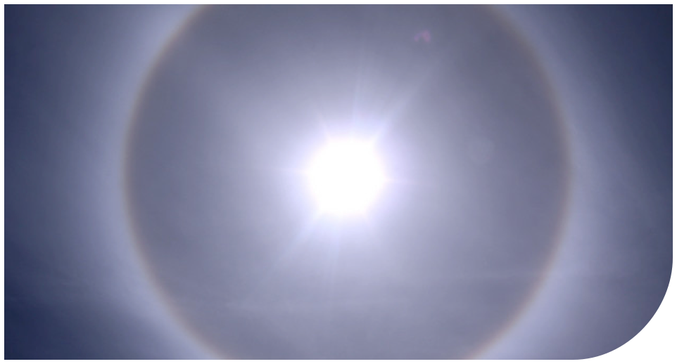
vfc©
cirrostratus cs

Slide 169
Cloud middle clouds
vfc©
middle clouds are composed of ice crystals or water droplets
they are denoted using the prefix alto-

Slide 170

vfc©
altostratus as

Slide 171

vfc©
altocumulus ac

Slide 172

vfc©
altocumulus castellanus acc

Slide 173
Cloud low clouds
vfc©
low clouds are composed of ice crystals or water droplets
they do not use one specific prefix

Slide 174
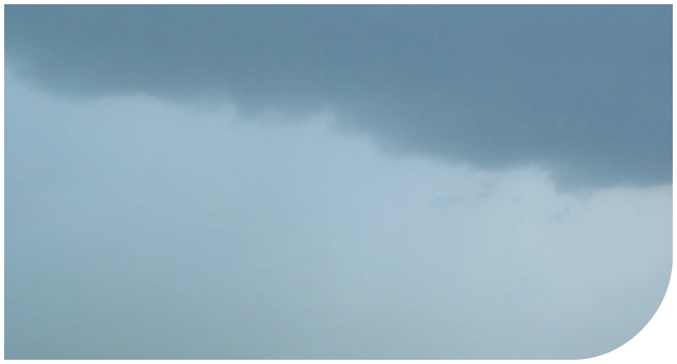
vfc©
stratus st

Slide 175
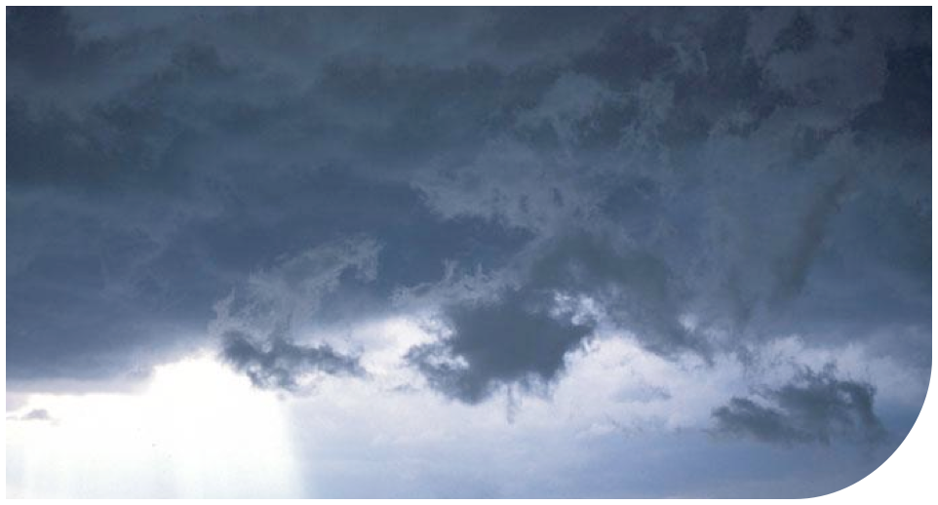
vfc©
stratus fractus sf

Slide 176
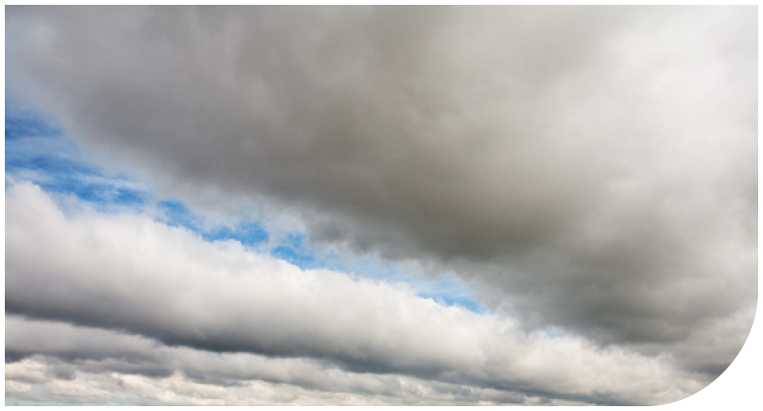
vfc©
stratocumulus sc

Slide 177
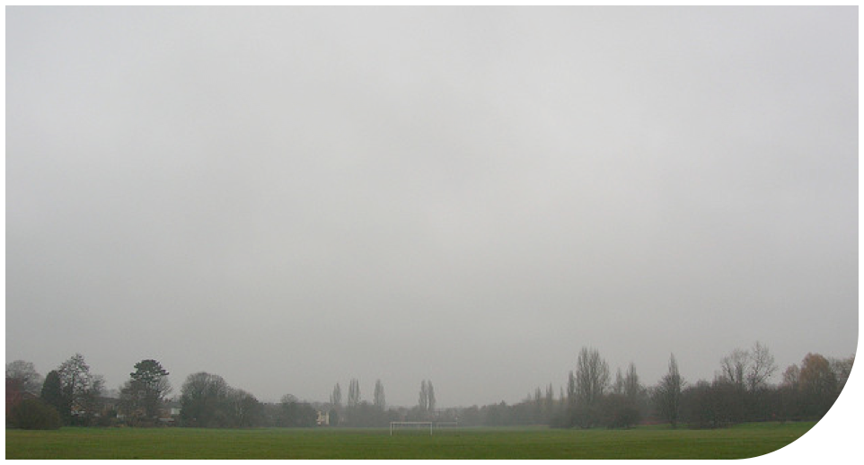
vfc©
nimbostratus ns

Slide 178
Cloud vertically developed clouds
vfc©
vertically developed clouds are often composed of water in all of its states
due to extensive vertical height and thus differing temperature regions within the cloud

Slide 179

vfc©
cumulus cu

Slide 180

vfc©
towering cumulus tcu

Slide 181
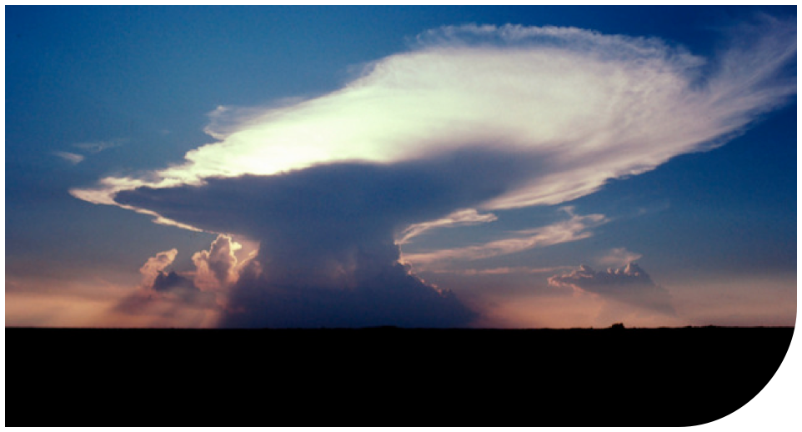
vfc©
cumulonimbus cb

Slide 182
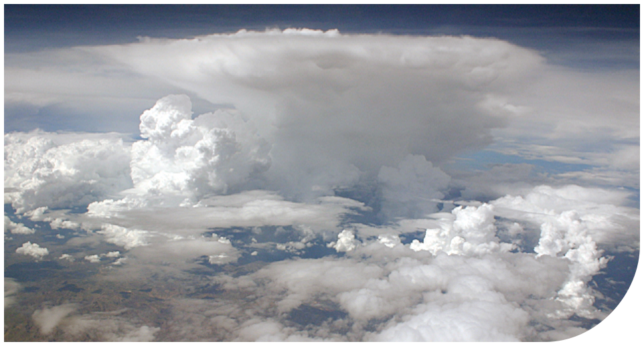
vfc©
cumulonimbus cb

Slide 183
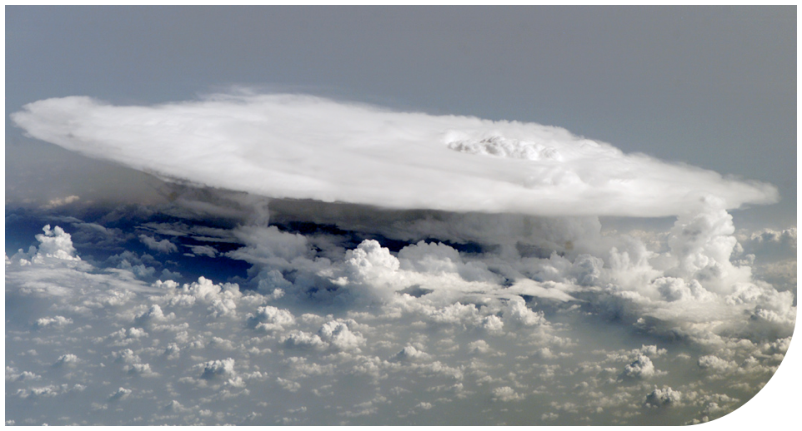
vfc©
cumulonimbus cb

Slide 184

precipitation
vfc©

Slide 185
Precipitation formation
vfc©
precipitation formation is due to two main factors
both of these factors involve moisture in cloud becoming too massive to support aloft

Slide 186
Precipitation coalescence
vfc©
water droplets collide with each other in cloud, becoming more massive, termed coalescence
eventually they fall when the uplifting force in cloud is outweighed by their mass, and the droplets falling to the ground
coalescence is more prevalent in areas of cloud where the temperature is above freezing

Slide 187
Precipitation types
vfc©
there are numerous forms of precipitation, once it has formed due to coalescence or sublimation
stratoform clouds yield continuous and light/moderate intensity precipitation
cumuloform clouds yield intermittent and intense precipitation

Slide 188
Precipitation rain
vfc©
rain is formed of large droplets
freezing rain is composed of super cooled water droplets which instantaneously freeze upon impact

Slide 189
Precipitation super cooling
vfc©
water may exist as a liquid at temperatures as low as -42°C
due to a lack of nuclei around which a crystal may form
supercooled demonstration

Slide 190
Precipitation drizzle
vfc©
drizzle are small droplets that appear suspended
freezing drizzle occurs when drizzle freezes on impact with cold objects

Slide 191
Precipitation hail
vfc©
hail forms in cumulonimbus clouds as ice crystals collide with supercooled water droplets
the large mass of hail stones requires an immense uplifting force in cloud for their creation, only present in well developed cumuloform cloud

Slide 192
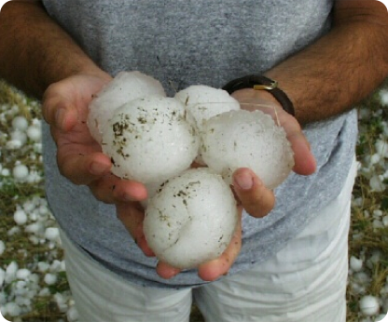
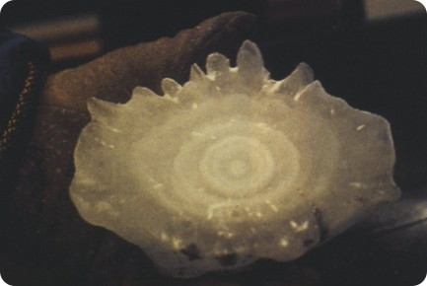
Precipitation hail
vfc©

Slide 193
Precipitation snow
vfc©
snow is created through sublimation in cloud
its state at the surface is dependant on the ambient air temperature

Slide 194
Precipitation snow pellets
vfc©
hail that does not acquire a hard outer coating of ice is termed a snow pellet, or soft hail
this occurs when the water region of the cloud is of limited depth

Slide 195
Precipitation ice pellets
vfc©
ice pellets are formed by rain drops freezing
they are hard and transparent, and rebound upon striking a surface

Slide 196
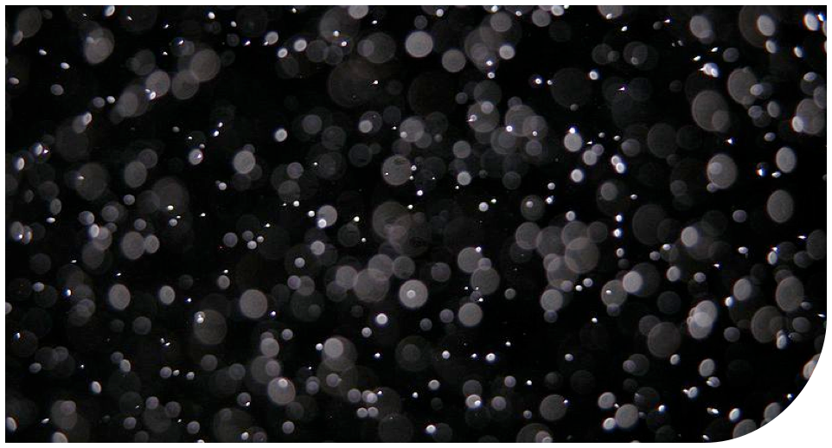
fog
vfc©

Slide 197
Fog formation
vfc©
fog is simply visible moisture in contact with the surface
fog formation is identical to cloud formation, however the atmospheric moisture generating the fog is localized and the fog low lying
moisture laden air saturates forming fog in different ways

Slide 198
Fog formation
vfc©
ideal fog formation conditions, besides high humidity in the presence of condensation nuclei, include light surface winds or instability
if there is no lifting or mixing action in low lying air, dew or frost may form
moisture laden air saturates forming fog in many different ways

Slide 199

Fog radiation
vfc©
radiation fog forms on cold, clear nights in low areas such as valleys
Notes:
Radiation fog begins to form over land usually under clear skies and light winds typically after midnight and peaks early in the morning. As the land surface loses heat and radiates it into space, the air above the land is cooled and loses its ability to hold moisture. If an abundance of condensation nuclei is present in the atmosphere, radiation fog may develop before the temperature-dewpoint spread reaches zero. After sunrise, the fog begins to burn off from the edges over land but any fog that has drifted over water will take longer to burn off.

Slide 200

Fog advection
vfc©
advection fog forms in coastal areas as warm, moist air laden with salt (nuclei) is advectively cooled
Notes:
Fog that forms when warm moist air moves across a snow, ice or cold water surface.

Slide 201
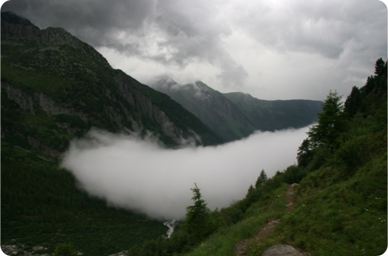
Fog upslope
vfc©
air adiabatically cools and saturates as it is forced up a slope

Slide 202

Fog steam
vfc©
warm water evaporates into the colder air lying just above it, saturating the air
Notes:
Steam fog forms when very cold arctic air moves over relatively warmer water. In this case moisture evaporates from the water surface and saturates the air. The extremely cold air cannot hold all the evaporated moisture, so the excess condenses into fog. The result looks like steam or smoke rising from the water, and is usually no more than 50 to 100 feet thick. Steam fog, also called arctic sea smoke, can produce significant icing conditions.

Slide 203
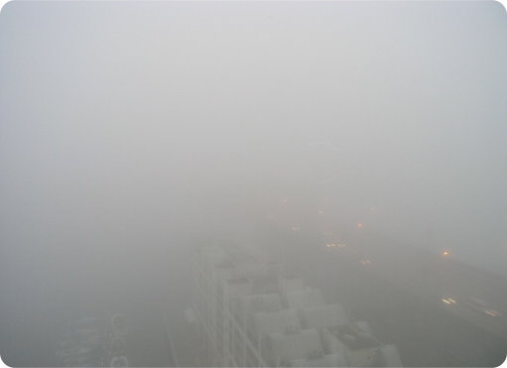
Fog precipitation
vfc©
precipitation evaporates into air it is falling through, saturating it to its dewpoint
Notes:
Precipitation fog, or frontal fog, forms ahead of warm fronts when precipitation falls through a cooler layer of air near the ground. The precipitation saturates the air at the surface and fog forms. Breaks in the precipitation usually results in the fog becoming thicker.

Slide 204

Fog ice
vfc©
the droplets in extremely cold saturated air freeze in suspension
Notes:
Ice fog occurs when water vapour sublimates directly into ice crystals. In conditions of light winds and temperatures colder than -30°C or so, water vapour from manmade sources or cracks in ice-covered rivers can form widespread and persistent ice fog. The fog produced by local heating systems, and even aircraft engines, can reduce the local visibility to near zero, closing an airport for hours or even days.

Slide 205
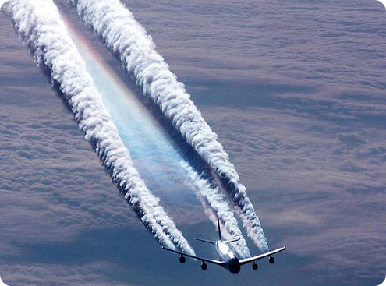
Fog ice
vfc©
hot exhaust gases saturate cold air extremely quickly, producing ice fog, in this case known as contrails

Slide 206
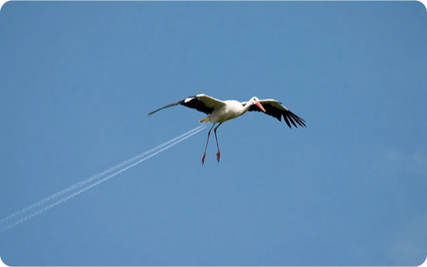
Fog ice
vfc©
the ellusive twin engined stork

Slide 207
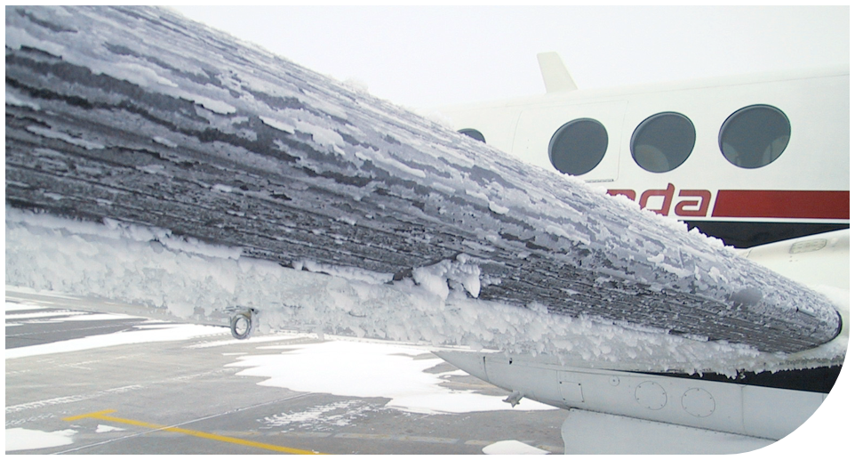
icing
vfc©

Slide 208
Icing super cooled
vfc©
supercooled water droplet impact by an aircraft wing at temperatures below freezing will cause icing
the quantity of supercooled droplets is dependent on the liquid water content of the cloud
clouds formed to due convection, lee wave turbulence, and orographic lift contain the largest size of water droplets due to their powerful lift

Slide 209
Icing rime
vfc©
rime ice is milky-white, opaque, and is formed by almost instantaneous freezing of small water droplets at temperatures well below freezing
it tends to form only on the leading edges of airfoils, and builds forward into the airstream
because it is not very adhesive, it is relatively easy to remove with de-icing equipment

Slide 210
Icing clear
vfc©
clear ice may vary from a transparent appearance to a very rough, opaque texture created from by a slow freezing process of large water droplets
the free droplet that didn’t freeze on initial impact moves aft and continues to freeze at temperatures not far below freezing
it may spread from the leading edges of the aircraft to cover it entirely in severe cases

Slide 211
Icing clear
vfc©
because of its irregular freezing process it may create unique shapes the protrude from the aircraft
it is tougher to remove with de-icing equipment than rime
clear icing is a greater hazard than rime icing

Slide 212
Icing mixed
vfc©
mixed icing is a combination of rime and clear
frequently the cloud temperature and range of droplet sizes are such that conditions are conducive to mixed ice formation

Slide 213
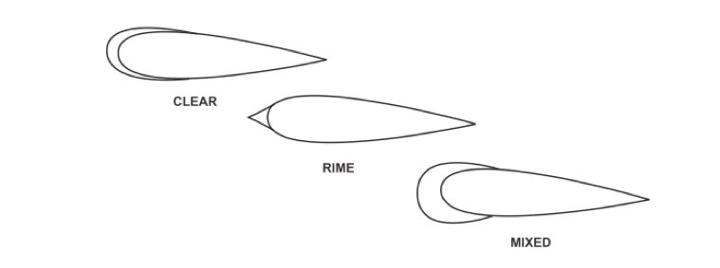
Icing types
vfc©

Slide 214
Icing temperature
vfc©
warm air will present a greater quantity of water droplets than cold air
larger droplets begin to spontaneously freeze to crystals around -10°C
colder temperatures are required to freeze smaller droplets

Slide 215
Icing temperature
vfc©
the rate of freezing markedly increases at temperatures just below -15°C
larger droplets begin to spontaneously freeze to crystals around -10°C
by -40°C virtually all droplets will have frozen, therefore the chances of aircraft icing below -40°C are lower

Slide 216
Icing intensity
vfc©
trace icing accumulates at a rate only slightly greater than it sublimates
not hazardous, even without anti/de-ice equipment, unless encountered for over an hour

Slide 217
Icing intensity
vfc©
light icing may pose a problem if encountered for more than an hour
does not pose a problem if anti/de-ice equipment is installed and used

Slide 218
Icing intensity
vfc©
moderate icing creates potentially hazardous situations, even if encountered for a short period of time
use of anti-de-ice equipment, or a diversion, is necessary

Slide 219
Icing intensity
vfc©
severe icing accumulates at a rate such that anti/de-ice equipment does not decrease the hazard
an immediate diversion is the one and only option

Slide 220
Icing intensity
vfc©
these terms of intensity are subjective to each individual aircraft
whether the icing intensity is light for one aircraft and medium for another depends on the qualitative effect on flight characteristics, and should be determined on a case by case basis

Slide 221
Icing freezing process
vfc©
when a super cooled droplet freezes, latent heat of fusion is released which warms the remaining droplet to 0°C
droplet continues to freeze, but more slowly
fraction of droplet that initially freezes greater with colder temperatures
after initial impact, rate of freezing depends on temperature of aircraft skin and air temperature

Slide 222
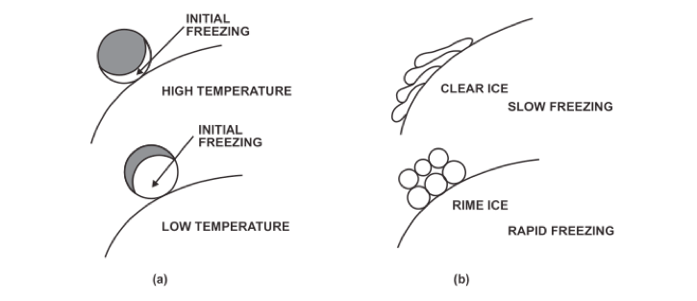
Icing freezing process
vfc©

Slide 223
Icing in clear air
vfc©
icing in clear air is possible, meaning you DO NOT have to be in cloud to accumulate ice
ice accumulation in clear air is known as hoar frost

Slide 224
Icing hoar frost
vfc©
hoar frost is a crystalline, feathery-white frost that may cover an entire aircraft
similar to the frost that forms on a car roof on cold, clear nights
forms due to deposition as warm, moist air comes in contact with a sufficiently cold surface

Slide 225
Icing hoar frost
vfc©
parked aircraft are susceptible to hoar frost formation, especially on their upper surfaces as they radiately cool
hoar frost may also form on aircraft in flight that have been cold-soaked by flying at temperatures below freezing and then descend into warm, moist air
frequently the frost forms in the vicinity of integral fuel tanks as the cold fuel warms slower than the rest of the aircraft

Slide 226
Icing collection efficiency
vfc©
collection efficiency is the fraction of liquid water which collects as ice on an aircraft
this efficiency varies directly with droplet size, aircraft speed and inversely with the geometric size of the collecting surface
a thin, fast wing travelling through an area containing large supercooled water droplets will be most efficient in ice collection

Slide 227

Icing collection efficiency
vfc©

Slide 228
Icing law
vfc©
it is against the law to take-off with any ice accumulation on an aircraft’s critical surfaces
CAR 602.11 (2): no person shall conduct or attempt to conduct a take-off in an aircraft that has frost, ice or snow adhering to any of its critical surfaces
critical surfaces means the wings, control surfaces, rotors, propellers, horizontal stabilizers, vertical stabilizers or any other stabilizing surface of the aircraft

Slide 229
Icing effect
vfc©
it must be understood that every effect of aircraft icing has the potential to be extremely hazardous to flight
the cumulative effect of aircraft icing is an increased stalling speed
this is the greatest danger of aircraft icing

Slide 230

Icing effect
vfc©

Slide 231

mountainwave
vfc©

Slide 232
Mountain wave disturbances
vfc©
air moves in relation to a mountain or mountain ridge which in may create a series of disturbances
air is initially forced up, followed by a sharp drop downwind of the peak
further downwind the air movement may continue as a series of wave-like oscillations termed a mountain wave

Slide 233
Mountain wave disturbances
vfc©
the intensity of the possible oscillations is dependant on the height of the mountain, and how sharply the terrain drops off on the leeward side
the greater the height and the sharper the drop-off, the greater the oscillation
the wave length downwind averages 6 miles, with an amplitude up to 3000’

Slide 234

Mountain wave dimensions
vfc©

Slide 235
Mountain wave clouds
vfc©
if conditions are favourable, tell-tale clouds will form in certain parts of the wave
these should be used as warning signs of the inherent dangers of mountain waves

Slide 236

Mountain wave cap cloud
vfc©

Slide 237

Mountain wave cap cloud
vfc©

Slide 238

Mountain wave roll cloud
vfc©

Slide 239

Mountain wave lenticular cloud
vfc©

Slide 240

Mountain wave lenticular cloud
vfc©

Slide 241
Mountain wave dangers
vfc©
windshear
turbulence
convective currents
altimeter error
icing

Slide 242

Mountain wave dangers
vfc©

Slide 243

thunderstorm
vfc©

Slide 244
Thunderstorm formation
vfc©
thunderstorm formation depends on air characteristics
warm air with a high moisture content, instability, a steep lapse rate and a convective lifting agent will promote thunderstorm formation
the latent heat of vaporization in the lower region of the cloud, and of fusion in the upper region of the cloud accelerate the initial updraft and grow the cumulonimbus

Slide 245
Thunderstorm stages
vfc©
thunderstorm stages are identified by the shape of the cloud, the direction of air movement within the cloud, and the occurrence of precipitation
there are three main stages of the thunderstorm

Slide 246
Thunderstorm cumulus
vfc©
the first stage is the cumulus stage, when numerous small convective clouds merge and rapidly grow into a very large cell
only updrafts exist in the cumulus stage, are greatest in the upper levels and may reach 3000’ per minute
ice crystals and then rain form as cell builds past the freezing level, with drops eventually falling in cloud as they grow more massive
cumulus stage lasts about 20 minutes

Slide 247

Thunderstorm cumulus
vfc©

Slide 248
Thunderstorm mature
vfc©
the mature stage is marked by precipitation at earth’s surface
the cloud continues to grow, with updrafts reaching 6000’ per minute
strong winds in the tropopause carry the cloud ahead of the storm, creating a characteristic anvil shape

Slide 249

Thunderstorm anvil
vfc©

Slide 250
Thunderstorm mature
vfc©
precipitation drags air in the cloud down with it, and evaporation cools the air strengthening the downdraft mid-cloud
a gust front is created when this air pours out of the cloud and reaches the surface, spreading out
the gust front is marked by gusty surface winds, a sharp drop in temperature and abrupt rise in pressure

Slide 251
Thunderstorm mature
vfc©
ahead of the gust front, air rises up and over the incoming cold down-flowing air, flowing into the storm
as the gust front passes wind veers violently, sometimes up to 180°
the downdraft may originate short-lived but extremely violent winds known as microbursts

Slide 252

Thunderstorm mature
vfc©

Slide 253
Thunderstorm mature
vfc©
hail is most likely during the mature stage
Super cooled droplets begin to freeze, and other drops coalesce on them as they are cycled through the cloud, growing is size
small hail may be carried up and ejected laterally from the cloud

Slide 254
Thunderstorm mature
vfc©
lightning is a discharge from negative to positive within cloud, from cloud to ground or rarely from ground to cloud
thunder is the resultant noise as lightning heats the air so that it expands more rapidly than the speed of sound
the distance in miles to the lightning strike is estimated by counting seconds between lightning and thunder and dividing the number by five

Slide 255
Thunderstorm mature
vfc©
mature stage is the most violent stage
precipitation is most intense near the end of this stage
lasts for about 20-30 minutes
its end is marked by the updraft weakening and downdraft encompassing the entire cell

Slide 256
Thunderstorm mature
vfc©

Slide 257
Thunderstorm dissipating
vfc©
entire cell is a downdraft
mechanisms which generate precipitation, lightning, turbulence do not exist
longest yet least hazardous stage

Slide 258
Thunderstorm mature
vfc©

Slide 259

Thunderstorm cells
vfc©
a thunderstorm usually consists of two or more cells in different stages of their life cycles

Slide 260
Thunderstorm classification
vfc©
thunderstorms are classified based on the lifting action that triggers instability

Slide 261

Thunderstorm warm front
vfc©

Slide 262

Thunderstorm cold front
vfc©

Slide 263

Thunderstorm convective
vfc©

Slide 264

Thunderstorm orographic
vfc©

Slide 265

Thunderstorm hazards
vfc©

Slide 266

airmass
vfc©

Slide 267
Air mass defined
vfc©
an air mass is a large body of air, 1000 or more miles across
across the horizontal, an air mass has acquired fairly uniform properties of temperature and moisture
topped by the tropopause

Slide 268
Air mass characteristics
vfc©
the air mass characterizes the type of weather seen within it
they are classified based on their two defining properties

Slide 269
Air mass classification
vfc©
there are three relatively dry air masses:
continental arctic - cA
continental polar - cP
continental tropic - cT

Slide 270
Air mass classification
vfc©
there are three relatively moist air masses:
maritime arctic - mA
maritime polar - mP
maritime tropic - mT

Slide 271
Air mass classification
vfc©
continental arctic is the coldest driest air mass, has a very low tropopause and is very stable
maritime tropic is very warm and moist, has a high tropopause, and is very unstable
continental tropic has the highest tropopause, is very unstable and its source region is very small in North America

Slide 272

Air mass structure
vfc©
the warmer the air mass, the higher and colder its tropopause

Slide 273
Air mass source regions
vfc©
if an air mass remains over a particular region for an extended period of time it will acquire the properties of that region
these regions are termed source regions

Slide 274
Air mass modification
vfc©
if an air mass moves out of its source region, it may modify to become a new air mass
the degree of modification depends on the speed at which the mass is moving, and the moisture content and temperature difference between the mass and the new source region

Slide 275

Air mass warming from below
vfc©
an air mass warmed from below will develop convection and instability in its lower levels, which may be carried aloft

Slide 276

Air mass cooling from below
vfc©
an air mass cooled from below will develop stability in its lower levels, and modification is confined to the first few thousand feet

Slide 277

Air mass source regions
vfc©

Slide 278

fronts
vfc©

Slide 279
Fronts defined
vfc©
cold, dense air does not readily mix with warm, less dense air
along the border of two air masses, there is a relatively short transition zone of temperature change within 50-100 miles
this is a front, or frontal system

Slide 280
Fronts nomenclature
vfc©
fronts are named based on the colder air mass involved
this means it is the relative movement of cold air with relation to the warm air that describes a front

Slide 281

Fronts frontal systems
vfc©

Slide 282

Fronts cold
vfc©
the advancing edge of a cold air mass is termed a cold front
the cold air advances towards, and eventually will catch up with, the warm air

Slide 283

Fronts warm
vfc©
the retreating edge of a cold air mass is termed a warm front
the warm front is eventually caught up to by the cold front
or, the cold front eventually will catch up with itself

Slide 284

Fronts quasi-stationary
vfc©
a quasi-stationary front shows little relative movement of the cold air
with reference to the ground, it is moving at less than 5 kts

Slide 285
Fronts upper
vfc©
cold and warm fronts may also be referred to as upper fronts, meaning their frontal surface does not come in contact with the ground
there is an underlying mass of air with fairly uniform temperature causing the discontinuity of the frontal surface

Slide 286
Fronts frontogenesis
vfc©
the creation of a front is termed frontogenesis
this occurs when wind increases the temperature contrast within one air mass, creating two areas of differing temperature

Slide 287
Fronts frontolysis
vfc©
the dissipation of a front is termed frontolysis
this occurs when wind decreases the temperature contrast between two air masses to a point where there is no need for the front to exist
modification of two air masses that remain over the same source region may also cause frontolysis

Slide 288

Fronts structure
vfc©
remember that a front is in fact a mixing zone of air 50-100 miles across

Slide 289

Fronts structure
vfc©
it is important to see fronts from all perspectives to fully understand them

Slide 290

Fronts inversion
vfc©
an inversion is encountered during ascent from the surface through a cold front

Slide 291


Fronts North America
vfc©

Slide 292
Fronts motion
vfc©
frontal motion is dependent on the movement of the cold air perpendicular to it
the motion of the warm air does not affect frontal movement
this is true at both the cold front and the warm front

Slide 293

Fronts motion
vfc©

Slide 294
Fronts slope
vfc©
the slope a frontal surface makes with earth’s surface is extremely shallow, and in all cases it is in the realm of one degree
the shape of the frontal surface however varies significantly between the various fronts

Slide 295

Fronts slope
vfc©

Slide 296
Fronts going up
vfc©
two terms are used to describe the upwards movement that the warm air experiences at the cold and the warm front
at the warm front, the warm air overruns the retreating cold air, and it is lifted aloft
at the cold front, the advancing cold air aggressively lifts the warm air as it undercuts, creating frontal lift

Slide 297



Fronts frontal lift
vfc©

Slide 298



Fronts over running
vfc©

Slide 299
Fronts passage
vfc©
it is important to note the changes with respect to wind, temperature and pressure with both cold and warm front passage
these changes may appear in advance of a front passing, or be evident only during or after its passage

Slide 300
Fronts cold front passage
vfc©
weather | before passage | with passage | after passage
temperature | warm | suddenly cooling | steady cooling
pressure | decreasing | decreasing to lowest point, then sudden increase | steady increase
winds | backing | variable, gusting | veering
visibility | fair to poor | poor but improving | good, except during showers

Slide 301
Fronts warm front passage
vfc©
weather | before passage | with passage | after passage
temperature | cool | sudden warming | warming, then sustaining
pressure | decreasing | sustaining | slight rise then decrease
winds | backing | variable | veering
visibility | poor | improving | fair

Slide 302
Fronts waves
vfc©
wave-like disturbances may form on quasi-stationary fronts that can produce extensive areas of cloud and precipitation
these waves may be stable or unstable

Slide 303

Fronts stable wave
vfc©

Slide 304

Fronts unstable wave
vfc©

Slide 305

Fronts trowal
vfc©
the trough of warm air that is lifted aloft during an unstable wave is termed a trowal

Slide 306
Fronts occlusion
vfc©
the advancing cold front catching up to the warm front is termed an occlusion
it is a like a doing up a zipper with the resultant being a wedge of warm air pushed aloft
remember that in essence this is the cold front catching up to its own tail

Slide 307

Fronts occlusion
vfc©

Slide 308

Fronts cold front occlusion
vfc©
cold air advances on and lifts its retreating cool tail, which in turn lifts warm air aloft

Slide 309

Fronts warm front occlusion
vfc©
cool air advances on and overruns its retreating cold tail, which lifts warm air aloft

Slide 310
Fronts weather
vfc©
each type of front creates a specific type of weather
this can range from little cloud formation with no precipitation, to aggressive thunderstorms with intense precipitation
the weather seen at the front depends on the characteristics of the warm air mass

Slide 311



Fronts cold front weather
vfc©

Slide 312



Fronts warm front weather
vfc©

Slide 313

Fronts winter warm front
vfc©
rain falling from cloud in the cold air sector at a warm front has the potential to cause freezing rain and dangerous icing conditions

Slide 314

Fronts winter warm front
vfc©

Slide 315

Fronts trowal weather
vfc©

Slide 316
Day 3
vfc©
met advanced theory continued, jet stream, aviation weather products, sample exam and take-up

Slide 317

jetstream
vfc©

Slide 318
Jetstream defined
vfc©
jet streams are fast moving, narrow corridors of air within the main airflow
they may be thousands of miles long, hundreds of miles wide and a few thousand feet thick
the wind speed must be a minimum of 60 kts to qualify as a jet stream, and speeds in excess of 200 kts may occur

Slide 319
Jetstream frontal
vfc©
jet streams may be associated with frontal systems
they flow parallel to the surface position of the front, crossing at the point of occlusion and circling northwards around the low
the jet takes the name of the front causing it - arctic, polar or maritime

Slide 320

Jetstream frontal
vfc©

Slide 321
Jetstream frontal
vfc©
jet streams flow easterly, below the warm air tropopause of a front, and at approximately the same level of the cold air tropopause
looking down the jet stream, air rotates counter-clockwise, rising to the south and descending to the north
if the ascending air is moist, cirrus clouds may form, with fibrous edges denoting the strong vertical shear

Slide 322

Jetstream structure
vfc©

Slide 323

Jetstream structure
vfc©

Slide 324
Jetstream variation
vfc©
the jet stream position varies with the movement of the front it is associated with
the fronts themselves migrate depending on the season
the tropopause is higher in summer, and lower in winter
jet streams also meander in height along their length

Slide 325
Jetstream variation
vfc©
during winter in the mid-latitudes in the northern hemisphere, there is a greater temperature contrast over land areas than in summer
fronts move further to the south in winter with lower tropopause heights
associated frontal jet streams are therefore lower and stronger in intensity (due to the greater temperature contrast) in winter than in summer

Slide 326

navcanada
vfc©

Slide 327
Nav Canada provider
vfc©
Nav Canada is Canada’s civil air navigation service provider of...
air traffic control
flight information
weather briefings

Slide 328
Nav Canada provider
vfc©
aeronautical information services
airport advisory services
electronic aids to navigation
the aviation weather website - AWWS

Slide 329
Nav Canada weather briefings
vfc©
one way aviation weather may be obtained is through a pilot interpretative weather briefing provided by a NavCanada flight information center (FIC)
FICs may be contacted via toll free telephone from anywhere in Canada
1-866-WXBRIEF (1-866-992-7433)

Slide 330

Nav Canada FIC
vfc©

Slide 331
Nav Canada weather briefings
vfc©
when calling for a weather briefing, be prepared to give the following information:
aircraft registration and type
operation type - VFR
route
estimated zulu time of departure
planned altitude
estimated time en route

Slide 332
Nav Canada inflight weather
vfc©
there are numerous ways to obtain weather information during flight
air traffic control
FICs via “Pacific Radio”
ATIS
voice generator module

Slide 333
Nav Canada inflight weather
vfc©
there are numerous ways to obtain weather information during flight
air traffic control
FICs via “Pacific Radio”
ATIS
voice generator module

Slide 334
information
vfc©
RVRRWY331200V2600
prob30
fc
SLP987
lwis
A2976
metar
fg
auto
cig
blo040
fu
FL080
ovc
-dz
br
pressrr
taf
notam
fldurd
cu2st4acc1
+snsh
fm
3/4SM
pirep
mdt
becmg
sc3
cyyj
ra
sf4
blsa
fd
M01/M05
hj
bkn
ws
VV002
skc
few
cb
sct
vis
tcu
tempo
ua
nil
fcst
10018G25KT
rime
speci
rmk
10/03
fzdz
awos
1803Z

Slide 335



Information sources and references
vfc©

Slide 336

Information classification
vfc©

Slide 337
Information METAR
vfc©
a METAR is an aviation routine weather report
it observes actual weather conditions, as observed from the ground, within a 5 NM radius of the reporting station
the report is composed of several coded groups, always in the same relative position

Slide 338
Information METAR
vfc©
METAR CYYJ 250000Z CCA 13015G25KT 3/4SM R27/4000FT/D -DZ BR BKN002 OVC005 08/08 A3026 RERA WS RWY27 RMK SF5SF3 VIS 3/8 TO NW SLP247=

Slide 339
Metar report type
vfc©
signifies a METAR report
always issued on the top of the zulu hour
issued 24 hours per day at all international airports in Canada
CYYJ 250000Z CCA 13015G25KT 3/4SM R27/4000FT/D -DZ BR BKN002 OVC005 08/08 A3026 RERA WS RWY27 RMK SF5SF3 VIS 3/8 TO NW SLP247=
METAR

Slide 340
Metar station
vfc©
METAR 250000Z CCA 13015G25KT 3/4SM R27/4000FT/D -DZ BR BKN002 OVC005 08/08 A3026 RERA WS RWY27 RMK SF5SF3 VIS 3/8 TO NW SLP247=
4 letter ICAO identifier of the reporting station
all Canadian stations commence with “C”
CYYJ

Slide 341
Metar date and time
vfc©
the day of the month is followed by the zulu time of the report issuance
zulu time is exclusively used in aviation weather
METAR CYYJ CCA 13015G25KT 3/4SM R27/4000FT/D -DZ BR BKN002 OVC005 08/08 A3026 RERA WS RWY27 RMK SF5SF3 VIS 3/8 TO NW SLP247=
250000Z

Slide 342
Metar correction
vfc©
this code is used to correct a previous report due to observer or instrumentation error
the first correction uses the designator “A”, the second correction “B” etc.
METAR CYYJ 250000Z 13015G25KT 3/4SM R27/4000FT/D -DZ BR BKN002 OVC005 08/08 A3026 RERA WS RWY27 RMK SF5SF3 VIS 3/8 TO NW SLP247=
CCA

Slide 343
Metar wind
vfc©
wind is reported as a two minute mean direction and speed, including gusts if observed
gusts are included if in the ten minutes prior to the report, the gust exceeds mean wind by 5 kts or more, and the gust itself is 15 kts or stronger
wind direction in metar is always reported as true
METAR CYYJ 250000Z CCA 3/4SM R27/4000FT/D -DZ BR BKN002 OVC005 08/08 A3026 RERA WS RWY27 RMK SF5SF3 VIS 3/8 TO NW SLP247=
13015G25KT

Slide 344
Metar visibility
vfc©
the minimum prevailing ground visibility is reported in statute miles (SM)
an observer can only see point to point, along a statute mile
nautical miles are never used to report visibility
METAR CYYJ 250000Z CCA 13015G25KT R27/4000FT/D -DZ BR BKN002 OVC005 08/08 A3026 RERA WS RWY27 RMK SF5SF3 VIS 3/8 TO NW SLP247=
3/4SM

Slide 345
Metar runway visual range
vfc©
runway visual range (RVR) reports ground visibility in feet if below 1 NM for a particular runway
trend is indicated if the visibility changes 300’ or more in the five minutes preceeding observation
/U = upwards trend
/D = downwards trend
/N = no distinct trend
METAR CYYJ 250000Z CCA 13015G25KT 3/4SM
-DZ BR BKN002 OVC005 08/08 A3026 RERA WS RWY27 RMK SF5SF3 VIS 3/8 TO NW SLP247=
R27/4000FT/D

Slide 346
Metar present weather
vfc©
this code describes one or more forms of precipitation, obscuration or other phenomenon
placed before the code are descriptors of intensity, proximity to the station, or other
present weather is coded by the World Meteorological Organization Code, table 4678
METAR CYYJ 250000Z CCA 13015G25KT 3/4SM
R27/4000FT/D BKN002 OVC005 08/08 A3026 RERA WS RWY27 RMK SF5SF3 VIS 3/8 TO NW SLP247=
-DZ BR

Slide 347

Metar present weather
vfc©

Slide 348
Metar sky condition
vfc©
cloud bases are reported in hundreds of feet AGL
placed before these altitudes are summative terms that describe, in oktas (eighths), coverage of the sky
METAR CYYJ 250000Z CCA 13015G25KT 3/4SM
R27/4000FT/D -DZ BR 08/08 A3026 RERA WS RWY27 RMK SF5SF3 VIS 3/8 TO NW SLP247=
BKN002 OVC005

Slide 349


Metar sky condition
vfc©
OVC
(overcast) 8/8
FEW (few)
<0/8 - 2/8
BKN (broken)
<4/8 - >8/8
SCT (scattered)
<2/8 - 4/8

Slide 350

2/8
3/8
2/8
FEW
SCT
BKN
OVC
1/8
+
+
+
10 NM

Slide 351
Metar sky condition
vfc©
the height of the first reported layer of broken (BKN), overcast (OVC) or vertical visbility (VV) is termed a ceiling
a VFR pilot may not fly above the altitude of a summative cloud ceiling
this is true even if there is clear air below and the ground is visible

Slide 352
OVC
2/8
BKN
3/8
SCT
2/8
FEW
1/8
10 NM

Slide 353
Metar temperature and dew point
vfc©
temperature and dewpoint are rounded to the nearest Celsius degree
the spread between them is an expression of relative humidity
METAR CYYJ 250000Z CCA 13015G25KT 3/4SM
R27/4000FT/D -DZ BR BKN002 OVC005 A3026 RERA WS RWY27 RMK SF5SF3 VIS 3/8 TO NW SLP247=
08/08

Slide 354
Metar altimeter setting
vfc©
METAR CYYJ 250000Z CCA 13015G25KT 3/4SM
R27/4000FT/D -DZ BR BKN002 OVC005 08/08 RERA WS RWY27 RMK SF5SF3 VIS 3/8 TO NW SLP247=
the altimeter setting is reported to the nearest hundredth of “ Hg
insert the decimal before the 2nd to last number of the group
A3026

Slide 355
Metar recent weather
vfc©
recent weather of operational significance is reported here
this includes precipitation, blowing snow, storms or volcanic ash
recent implies the weather was seen following the previous report, but not at the issuing time of the current report
METAR CYYJ 250000Z CCA 13015G25KT 3/4SM
R27/4000FT/D -DZ BR BKN002 OVC005 08/08 A3026 WS RWY27 RMK SF5SF3 VIS 3/8 TO NW SLP247=
RERA

Slide 356
Metar wind shear
vfc©
windshear, if known, is reported when occurring within 1600‘ AGL along an approach or departure path of a specific runway
this knowledge should be combined with the mean wind observance to identify the specific type of performance shear
METAR CYYJ 250000Z CCA 13015G25KT 3/4SM
R27/4000FT/D -DZ BR BKN002 OVC005 08/08 A3026 RERA RMK SF5SF3 VIS 3/8 TO NW SLP247=
WS RWY27

Slide 357
Metar remarks
vfc©
the first group of the remarks section indicates the cloud type of each layer, as well as the individual opacity (coverage) of each cloud layer, that was reported by sky condition
sky condition and this section of the remarks should to be used together to gain a complete picture of the observed cloud
METAR CYYJ 250000Z CCA 13015G25KT 3/4SM
R27/4000FT/D -DZ BR BKN002 OVC005 08/08 A3026 RERA WS RWY27 VIS 3/8 TO NW SLP247=
RMK SF5SF3

Slide 358
Metar remarks
vfc©
METAR CYYJ 250000Z CCA 13015G25KT 3/4SM
R27/4000FT/D -DZ BR 08/08 A3026 RERA WS RWY27 RMK VIS 3/8 TO NW SLP247=
BKN002
OVC005
SF5
SF3
10 NM

Slide 359
Metar remarks
vfc©
sector visibility is reported if half or less of the prevailing visibility is observed in a particular sector
the sector visibility, in SM, is followed by which sector is reporting it, as a compass direction referenced from the station
METAR CYYJ 250000Z CCA 13015G25KT 3/4SM
R27/4000FT/D -DZ BR BKN002 OVC005 08/08 A3026 RERA WS RWY27 RMK SF5SF3 SLP247=
VIS 3/8 TO NW

Slide 360
Metar remarks
vfc©
sea level pressure is the last part of the remarks code
it is abbreviated, and expressed in millibars
METAR CYYJ 250000Z CCA 13015G25KT 3/4SM
R27/4000FT/D -DZ BR BKN002 OVC005 08/08 A3026 RERA WS RWY27 RMK SF5SF3 VIS 3/8 TO NW
SLP247 =

Slide 361
Metar remarks
vfc©
10
.
9/
247
METAR CYYJ 250000Z CCA 13015G25KT 3/4SM
R27/4000FT/D -DZ BR BKN002 OVC005 08/08 A3026 RERA WS RWY27 RMK SF5SF3 VIS 3/8 TO NW
mb
SLP247 =

Slide 362
Speci off hour
vfc©
between METAR issuances, weather conditions may change
if conditions change such that a new report is warranted, an off-hour report of similar format to a METAR will be issued
this observance is termed a SPECI

Slide 363
Speci off hour
vfc©
a SPECI may describe the commencement, cessation or change in sky condition, visibility, wind, precipitation, temperature or severe weather phenomena
a SPECI does not report observed changes in dew point, altimeter setting, or sea level pressure

Slide 364
Speci off hour
vfc©
METAR CYYJ 250000Z CCA 13015G25KT 3/4SM
R27/4000FT/D -DZ BR BKN002 OVC005 08/08 A3026 RERA WS RWY27 RMK SF5SF3 VIS 3/8 TO NW SLP247 =
SPECI CYYJ 250023Z 18022G37KT 3/8SM R27/1200FT/D FZRA BKN001 OVC003 M01/ RMK SF6ST3=

Slide 365
Awos automated
vfc©
at some weather stations it is not feasible to have a human observer
at these stations, automated weather observation system (AWOS) sensors may be installed

Slide 366
Awos automated
vfc©
AWOS sensors are capable of measuring wind, layer height, sky cover, visibility, temperature, dew point, altimeter setting, precipitation, icing and sea level pressure
to indicate AWOS sensors are being used, the term AUTO is used after the date/time group in a METAR or SPECI code

Slide 367
Awos automated
vfc©
METAR CYHE 072100Z AUTO 14008KT 9SM CLR M04/M19 A3021 RMK SLP233=

Slide 368

metar/speci accessing
vfc©

Slide 369
Taf terminal areadrome forecast
vfc©
the terminal areadrome forecast (TAF) is to a local forecast what the METAR is to a local observation
the TAF forecasts within a 5 NM radius of the forecasting station
the TAF is always coded in groups in the same relative position to one another

Slide 370
Taf terminal areadrome forecast
vfc©
at international airports in Canada the TAF is valid for a minimum of 24 hours up to a maximum of 30 under the ICAO format
other stations may issue TAFs for shorter validity periods, depending on operational requirements
TAFs are issued at least every six hours

Slide 371

Taf stations
vfc©

Slide 372

Taf example
vfc©

Slide 373
Taf example
vfc©
TAF CYDN 291145Z 2912/3012 24010G25KT WS01127050KT 3SM -SN BKN010 OVC040 TEMPO 2918/3001 1 1/2SM -SN BLSN BKN008 PROB30 2920/2922 1/2SM SN VV005
FM300130 28010KT 5SM -SN BKN020
BECMG 3006/3008 00000KT SKC
RMK FCST BASED ON AUTO OBS NXT FCST BY 281800Z

Slide 374
Taf station identifier
vfc©
291145Z 2912/3012 24010G25KT WS01127050KT 3SM -SN BKN010 OVC040 TEMPO 2918/3001 1 1/2SM -SN BLSN BKN008 PROB30 2920/2922 1/2SM SN VV005
FM300130 28010KT 5SM -SN BKN020
BECMG 3006/3008 00000KT SKC
RMK FCST BASED ON AUTO OBS NXT FCST BY 281800Z
TAF CYDN
station identifier, ICAO format
TAF is the international format for an aerodrome forecast, if corrected will be indicated by AMD (amended)

Slide 375
Taf issuance
vfc©
TAF CYDN 2912/3012 24010G25KT WS01127050KT 3SM -SN BKN010 OVC040 TEMPO 2918/3001 1 1/2SM -SN BLSN BKN008 PROB30 2920/2922 1/2SM SN VV005
FM300130 28010KT 5SM -SN BKN020
BECMG 3006/3008 00000KT SKC
RMK FCST BASED ON AUTO OBS NXT FCST BY 281800Z
291145Z
the TAF issuing date and time are consistent with the METAR format

Slide 376
Taf validity
vfc©
TAF CYDN 291145Z 24010G25KT WS01127050KT 3SM -SN BKN010 OVC040 TEMPO 2918/3001 1 1/2SM -SN BLSN BKN008 PROB30 2920/2922 1/2SM SN VV005
FM300130 28010KT 5SM -SN BKN020
BECMG 3006/3008 00000KT SKC
RMK FCST BASED ON AUTO OBS NXT FCST BY 281800Z
2912/3012
validity time is coded as a time bracket, from a specific day and zulu hour, until a specific zulu hour
this start and end bracket is separated by a forward slash

Slide 377
Taf wind
vfc©
TAF CYDN 291145Z 2912/3012 WS01127050KT 3SM -SN BKN010 OVC040 TEMPO 2918/3001 1 1/2SM -SN BLSN BKN008 PROB30 2920/2922 1/2SM SN VV005
FM300130 28010KT 5SM -SN BKN020
BECMG 3006/3008 00000KT SKC
RMK FCST BASED ON AUTO OBS NXT FCST BY 281800Z
24010G25KT
wind is forecast in degrees true and in knots
if it’s written, it’s true
the same gust criteria as METAR applies

Slide 378
Taf wind shear
vfc©
TAF CYDN 291145Z 2912/3012 24010G25KT
3SM -SN BKN010 OVC040 TEMPO 2918/3001 1 1/2SM -SN BLSN BKN008 PROB30 2920/2922 1/2SM SN VV005
FM300130 28010KT 5SM -SN BKN020
BECMG 3006/3008 00000KT SKC
RMK FCST BASED ON AUTO OBS NXT FCST BY 281800Z
WS01127050KT
wind shear is forecast if the forecaster has strong evidence to believe that significant, non-convective wind shear will occur within 1500‘AGL of the station
often this evidence is based on pilot report

Slide 379
Taf visibility and sig weather
vfc©
prevailing visibility is forecast up to 3 SM in miles or fractions thereof, and then in whole SM up to 6 SM
visibilities forecast to be greater than 6 SM are coded as P6SM
significant weather codes are consistent with METAR
TAF CYDN 291145Z 2912/3012 24010G25KT
WS01127050KT BKN010 OVC040 TEMPO 2918/3001 1 1/2SM -SN BLSN BKN008 PROB30 2920/2922 1/2SM SN VV005
FM300130 28010KT 5SM -SN BKN020
BECMG 3006/3008 00000KT SKC
RMK FCST BASED ON AUTO OBS NXT FCST BY 281800Z
3SM -SN

Slide 380
Taf sky condition
vfc©
TAF CYDN 291145Z 2912/3012 24010G25KT
WS01127050KT 3SM -SN TEMPO 2918/3001 1 1/2SM -SN BLSN BKN008 PROB30 2920/2922 1/2SM SN VV005
FM300130 28010KT 5SM -SN BKN020
BECMG 3006/3008 00000KT SKC
RMK FCST BASED ON AUTO OBS NXT FCST BY 281800Z
BKN010 OVC040
cloud layers are consistent with METAR
forecast layers are summative in feet AGL

Slide 381
Taf tempo
vfc©
the TEMPO is a temporary change group of certain weather elements
weather groups following the abbreviation TEMPO will differ from those groups before it
TEMPO is in time bracket format
TEMPO states the changing elements will occur for no more than one hour, and if forecast to reoccur, will occur for a sum total of no more than 50% of the time bracket
TAF CYDN 291145Z 2912/3012 24010G25KT
WS01127050KT 3SM -SN BKN010 OVC040
1 1/2SM -SN BLSN BKN008 PROB30 2920/2922 1/2SM SN VV005
FM300130 28010KT 5SM -SN BKN020
BECMG 3006/3008 00000KT SKC
RMK FCST BASED ON AUTO OBS NXT FCST BY 281800Z
TEMPO 2918/3001

Slide 382
Taf tempo
vfc©
TAF CYDN 291145Z 2912/3012 24010G25KT
WS01127050KT 3SM -SN BKN010 OVC040
TEMPO 2918/3001 PROB30 2920/2922 1/2SM SN VV005
FM300130 28010KT 5SM -SN BKN020
BECMG 3006/3008 00000KT SKC
RMK FCST BASED ON AUTO OBS NXT FCST BY 281800Z
the changing elements are consistently coded
if a weather group is not indicated by TEMPO, it remains unchanged, as previously forecast
1 1/2SM -SN BLSN BKN008

Slide 383
Taf prob
vfc©
PROB describes the forecast probability of a change
it is included if there is the probability of thunderstorms, freezing precipitation or ceilings/visibility which may approach operational minima
PROB only indicates either a 30% or 40% chance of the forecast weather occurring
TAF CYDN 291145Z 2912/3012 24010G25KT
WS01127050KT 3SM -SN BKN010 OVC040
TEMPO 2918/3001 1 1/2SM -SN BLSN BKN008
PROB30 2920/2922
FM300130 28010KT 5SM -SN BKN020
BECMG 3006/3008 00000KT SKC
RMK FCST BASED ON AUTO OBS NXT FCST BY 281800Z
1/2SM SN VV005

Slide 384
Taf fm
vfc©
TAF CYDN 291145Z 2912/3012 24010G25KT
WS01127050KT 3SM -SN BKN010 OVC040
TEMPO 2918/3001 1 1/2SM -SN BLSN BKN008
PROB30 2920/2922 1/2SM SN VV005
BECMG 3006/3008 00000KT SKC
RMK FCST BASED ON AUTO OBS NXT FCST BY 281800Z
FM is used to forecast a rapid and permanent change
there is no time bracket associated with FM
it is a new, complete forecast within a TAF
even if elements are forecast to remain unchanged, they will be repeated within the FM change code
FM300130 28010KT 5SM -SN BKN020

Slide 385
Taf becmg
vfc©
BECMG is a gradual, permanent change
it is used when up to two elements are forecast to gradually change
the time bracket format is used
if a permanent change is expected in more than two elements, FM will be used
TAF CYDN 291145Z 2912/3012 24010G25KT
WS01127050KT 3SM -SN BKN010 OVC040
TEMPO 2918/3001 1 1/2SM -SN BLSN BKN008
PROB30 2920/2922 1/2SM SN VV005
FM300130 28010KT 5SM -SN BKN020
RMK FCST BASED ON AUTO OBS NXT FCST BY 281800Z
BECMG 3006/3008 00000KT SKC

Slide 386
Taf becmg
vfc©
TAF CYDN 291145Z 2912/3012 24010G25KT
WS01127050KT 3SM -SN BKN010 OVC040
TEMPO 2918/3001 1 1/2SM -SN BLSN BKN008
PROB30 2920/2922 1/2SM SN VV005
FM300130 28010KT 5SM -SN BKN020
BECMG 3006/3008 00000KT SKC
the remarks code will indicate if the forecast is based on AWOS
it will also indicate the time at which the next TAF will be issued by
TAF issuance commonly precedes its validity period by more than twenty minutes
RMK FCST BASED ON AUTO OBS NXT FCST BY 281800Z

Slide 387
Taf accessing
vfc©

Slide 388
Fd upper wind and temp
vfc©
the upper level wind and temperature forecast is know as FD
to generate this forecast, data is collected twice daily (00Z, 12Z) from 32 sites across Canada

Slide 389
Fd upper wind and temp
vfc©
wind direction (rounded to the nearest 10° true) and speed are forecast for all levels in 3000‘ increments ASL
temperature is forecast for all but the 3000‘ level, due to low level temperature variation

Slide 390

Fd upper wind and temp
vfc©

Slide 391
Fd accessing
vfc©

Slide 392
Pirep pilot report
vfc©
PIREP is a report of weather conditions encountered in flight by other pilots
PIREP is invaluable, and pilots are encouraged to file them, especially when significant weather phenomena are observed
PIREP reported as UACN10 are regular
PIREP reported as UACN01 are urgent

Slide 393
Pirep example
vfc©
UACN01 CYEG 270202 EG UUA /OV YYC 340010 /TM 0200 /FLUNKN /TP UNKN /RM PILOT ON GROUND REPORTS TORNADO MOVING WEST TO EAST
UACN01 CYKA 301613 VR UUA /OV CYVR 145030 /TM 1609 /FLDURD /TP DH8D /IC SEV MXD 090-120 /RM 20-30 NM ON GRIZZ.3 ARR IN CYVR. ACFT HAD NO CHOICE BUT TO DSND

Slide 394
Pirep accessing
vfc©

Slide 395
Information classification
vfc©

Slide 396
Graphical weather visual
vfc©
graphical weather uses a combination of symbology and alphanumeric code overlaid on a geographic map to create a weather analysis or forecast
the graphical area forecast (GFA) is one such product

Slide 397
Gfa background
vfc©
graphical weather uses a combination of symbology and alphanumeric code overlaid on a geographic map to create a weather analysis or forecast
the graphical area forecast (GFA) is one such product

Slide 398
Gfa coverage
vfc©
seven GFA domains provide complete domestic coverage of Canada
it consists of a series of weather charts that provide a 24 hour depiction of the most probable weather conditions forecast to occur over a specific area at a specific time, from the surface to 24000’ ASL

Slide 399
Gfa defined
vfc©
each GFA is in fact a series of weather charts, which are grouped into three sets
each set contains a chart that forecasts clouds and weather, and another chart that forecasts icing, turbulence, and the height of the freezing level

Slide 400
Gfa 24 hour coverage
vfc©
the first GFA set is valid at the beginning of the forecast period, for six hours
the second set is valid six hours into the forecast period, for six hours
the third GFA set is valid twelve hours into the forecast period, for twelve hours
this creates a comprehensive 24 hour forecast

Slide 401
Gfa issuance and validity
vfc©
GFA is issued every six hours, with four issuances a day
the issuance, as with any forecast, precedes validity time
GFA is issued before the top of the 0000, 0600, 1200 and 1800 zulu hours, the respective hours when each GFA becomes valid
every time GFA is issued the previous GFA is superseded

Slide 402
Gfa issuance and validity
vfc©
GFA is issued every six hours, with four issuances a day
the issuance, as with any forecast, precedes validity time
GFA is issued before the top of the 0000, 0600, 1200 and 1800 zulu hours, the respective hours when each GFA becomes valid
every time GFA is issued the previous GFA is superseded

Slide 403
Gfa issuance
vfc©
0000Z
1st set
1800Z
2nd set
0600Z
3rd set
1200Z

Slide 404

Gfa IFR outlook
vfc©
the third clouds and weather chart contains an additional IFR outlook
this will forecast IFR conditions based on the following criteria, for the 12 hour period the 3rd clouds and weather chart represents

Slide 405


Gfa example
vfc©

Slide 406


Gfa set 1
vfc©

Slide 407


Gfa set 2
vfc©

Slide 408


Gfa set 3
vfc©

Slide 409
Gfa accessing
vfc©

Slide 410
Gfa amendments
vfc©
one way GFA is amended by SIGMET
SIGMET is a short-term weather advisory to warn pilots of certain potentially hazardous weather phenomena
SIGMET is broadcast on appropriate IFR and VFR ATS frequencies upon receipt

Slide 411
Gfa amendments
vfc©
GFA is also amended by AIRMET
AIRMET is a short-term weather advisory to warn pilots of certain potentially hazardous weather phenomena, not warranting the issuance of SIGMET
SIGMET or AIRMET will be issued for weather occurrence without forecast, or non-occurrence with forecast

Slide 412
Sigmet example
vfc©
SIGMET
SIGMETS GFACN31
WSCN31 CWEG 131750 SIGMET M4 VALID 131750/132150 CWEG- WTN 25 NM OF LN /4936N12722W/65 S PORT HARDY - /5112N12812W/45 NW PORT HARDY - /5158N12814W/25 SE MCINNES ISLAND. PTCHY SEV MECH/LLWS TURB FCST BLO 040. SOLANDER ISLAND REPD SE60G72KT AT 1700Z. AREA QS. LTL CHG EXPD. END/GFA31/RGH/CMAC-W
WSCN31 CWEG 131633 SIGMET N1 VALID 131635/132035 CWEG- WTN 45 NM OF LN /5206N12448W/25 W PUNTZI MOUNTAIN - /4916N12028W/30 E HOPE. PTCHY SEV LEE WV/MECH TURB FCST BLO 100 DUE STG SWLY WNDS ALF. AREA QS. LTL CHG EXPD. END/1/GFA31/RGH/CMAC-W

Slide 413
airmet/sigmet accessing
vfc©

Slide 414
Sigwx mid level
vfc©
the significant weather mid-level prognostic chart covers all of Canada
it represents the 700mb to 400mb levels (FL100 to FL240)
they forecast icing, cloud layers of significance, marked mountain waves, FZLVL at 5000’ intervals, surface position and direction of movement of highs, lows, troughs etc.
issued four times per day, 12 hours before validity

Slide 415
Sigwx high level
vfc©
the significant weather high-level prognostic chart is produced by the world area forecast center (WAFC)
it represents from FL250 to FL630
it shows occurring or forecast weather conditions of concern to high level aircraft operations (ie. the jet stream, tropopause height, frontal positions etc.)
issued four times per day, 12 hours before validity

Slide 416


Sig weather
vfc©

Slide 417
Sig weather accessing
vfc©

Slide 418
Analysis charts anal
vfc©
certain weather parameters in the upper atmosphere are measured on constant pressure level charts
four pressure levels in Canada are recorded: 850mb (5000’), 700mb (10,000’), 500mb (18,000’) and 250mb (34,000’)
they are not forecast charts - they indicate past conditions
issued twice daily at 0000Z and 1200Z

Slide 419

Analysis charts anal
vfc©

Slide 420
Analysis charts anal
vfc©
analysis charts represent a common pressure level, not a constant altitude
highs and lows marked on the charts indicate the highest and lowest altitudes of the pressure level in that area
constant pressure level charts are useful as an aircraft flying a constant indicated altitude is flying a constant pressure level
therefore variations in aircraft altitude can be determined based on the contour lines indicated on ANAL charts

Slide 421


analysis
vfc©

Slide 422
Analysis accessing
vfc©

Slide 423
Notam notice to airmen
vfc©
NOTAM are coded messages that describe a change to an aeronautical facility, surface, procedure or hazard
they must be checked before each flight
NOTAM code is standardized in the Canadian Notam Procedures Manual
http://www.navcanada.ca/ContentDefinitionFiles/Publications/NOTAM/NOTAM_Manual_en.pdf

Slide 424
Notam example
vfc©
110098 CYXX HOPE
CYHE FIRST 1000 FT RWY 07 CLSD, USABLE RWY LEN REMAINING 2960 FT
TIL APRX 1103211900

Slide 425
Notam accessing
vfc©

Slide 426
Live RVR current wind
vfc©
LIVE RVR is a relatively new product created by NAVCANADA which displays current magnetic wind direction and speed at certain airports
this is overlaid on top of an airport diagram so is very intuitive and gives a clear relationship between runway orientation and wind direction
it is updated every 30 seconds

Slide 427
Live RVR accessing
vfc©

Slide 428
AWWS exploring
vfc©
the aviation weather website contains much more information than is required to be known for the CPL written test
however it should be explored as much as possible
make sure you are completely versed on the dissemination of any weather product you intend to use for flight planning purposes

